Slide 1
Reel Rescue -
Small Scale AV Digitisation
Common Problems – Shared Solutions Symposium 3 Nov 2021
Swee Cheng Wong
State Library of Queensland

Slide 2
Reel Rescue
Donor funded digitisation
Learnings from the critical digitisation of a small-scale audiovisual collection.
Challenges that were faced with digitising home movies

Slide 3
State Library of Queensland
State Library of Queensland 2018

Slide 4
About State Library Queensland
Leading reference and research library in QLD
Collects & preserves QLD’s cultural & documentary heritage
Books, maps, newspapers, objects, artworks, photographs & audiovisual items

Slide 5
AV Collection
2017 survey:
3000+ audiotapes
1300+ videotapes
1700+ optical discs
>2000 motion picture films

Slide 6
AV Collection
Audio: ¼”, compact cassettes, DAT, mini & micro cassettes, 78s, sound discs, CDs
Video: 2”, 1”, ½”, U-matic/SP, Betacam/SP, VHS, Mini-DV, DVDs, Laser discs
Films: 35mm; 16mm; 9.5mm; 8mm & Super8

Slide 7
Prior to Reel Rescue (till 2018)
Films donated: 20 – 50 items per year
Budget of $8K - $18K a year
Mix of audio/video/film selected on demand e.g. clients, exhibition use, significance
Films transferred to video files for digitisation

Slide 8
Queensland Library Foundation
An entity to raise money through donations, sponsorships & grants
Funds assist State Library to acquire, conserve and make accessible heritage collections, and deliver library programs throughout QLD
2018 – Fund raising for Reel Rescue Campaign including crowd giving events

Slide 13
Reel Rescue Fundraising Results
$35K after 2018 year end event
2019 – 2022, $200K (avg. of $66K per year)
To date, total of over $300K (staff resourcing, digitisation costs, supplies)

Slide 14
Targets
Digitise 90 – 120 films/items per year.
@Cost $64 (8mm 50ft) to $1400 (16mm 2000ft)
Expend up to $30K digitisation cost per year
Extra staff to help with RR work
Regular reporting to Executive Team and QLD Library Foundation

Slide 15
Takeaways from Fund-raising Campaign
Promotion = more incoming film collections.
Estimated 50% increase in film collection
State Library’s in kind support for RR – staff resourcing for selection, film prep, description, engagement work etc
Film vaults & digital storage filling up quickly

Slide 16
Initial Challenges – Film Digitising
Almost half the collection is 8mm/S8
2017-18: Most vendors in Australia only had archival 16/35mm film scanners
Prior to 2019, a vendor with URSA Diamond Telecine - Issues with the images prior to 2019
Looking to switch to frame by frame film scans

Slide 17
Previous Vendor

Slide 19
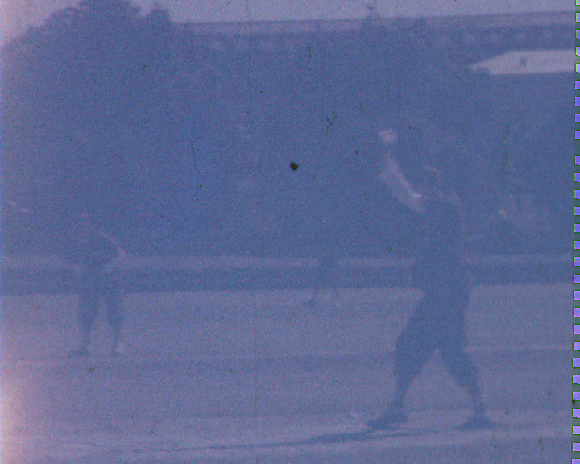

Slide 20
Searching for a new vendor…

Slide 21
Comparing Equipment for 16mm Spirit: Goldeneye: Blackmagic

Slide 22
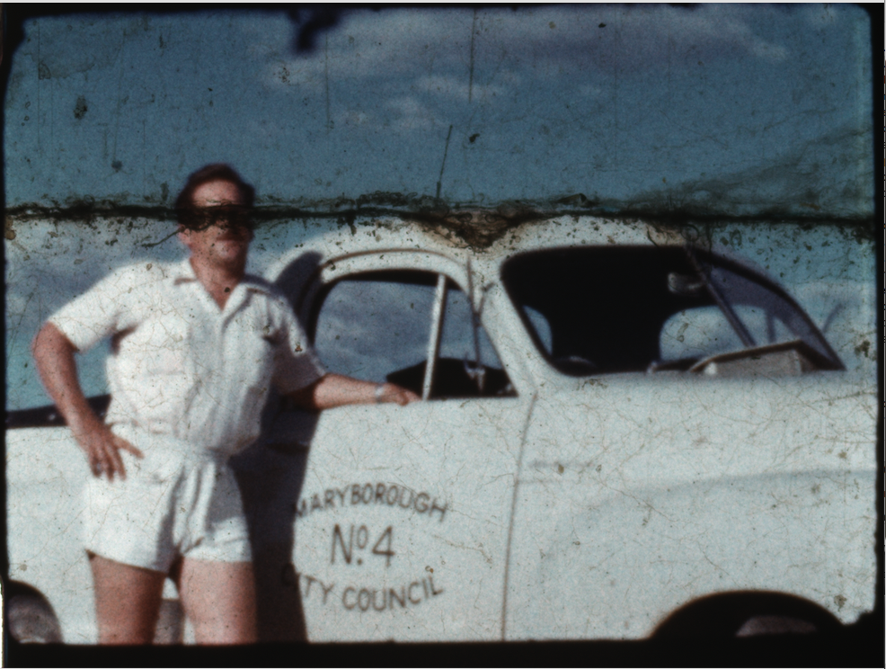
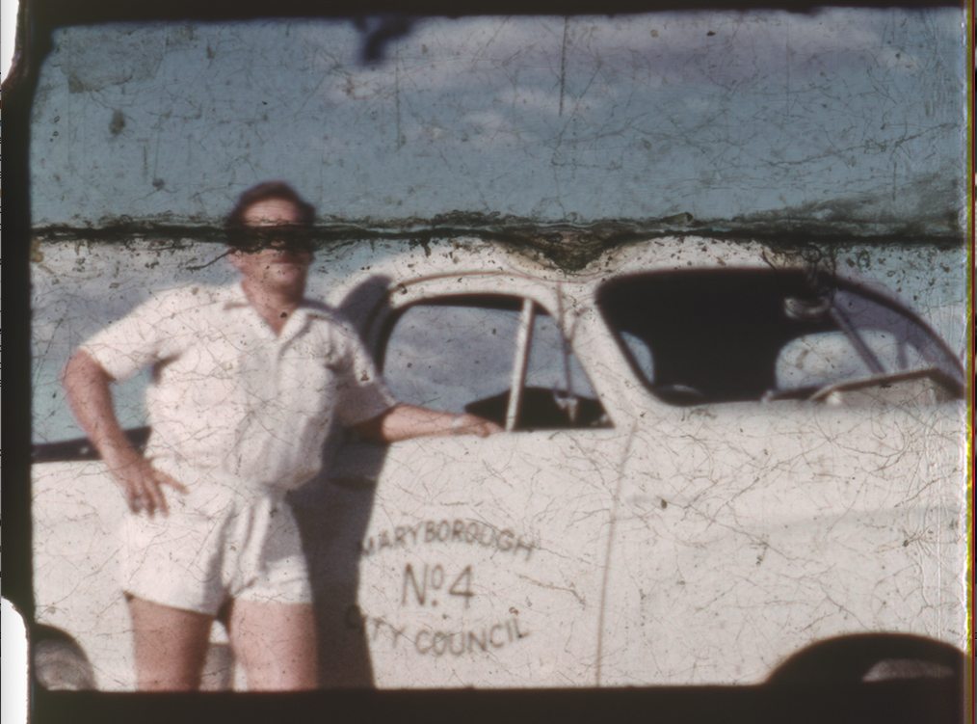
Shortlisted 8mm: Filmfabriek / Goldeneye

Slide 23
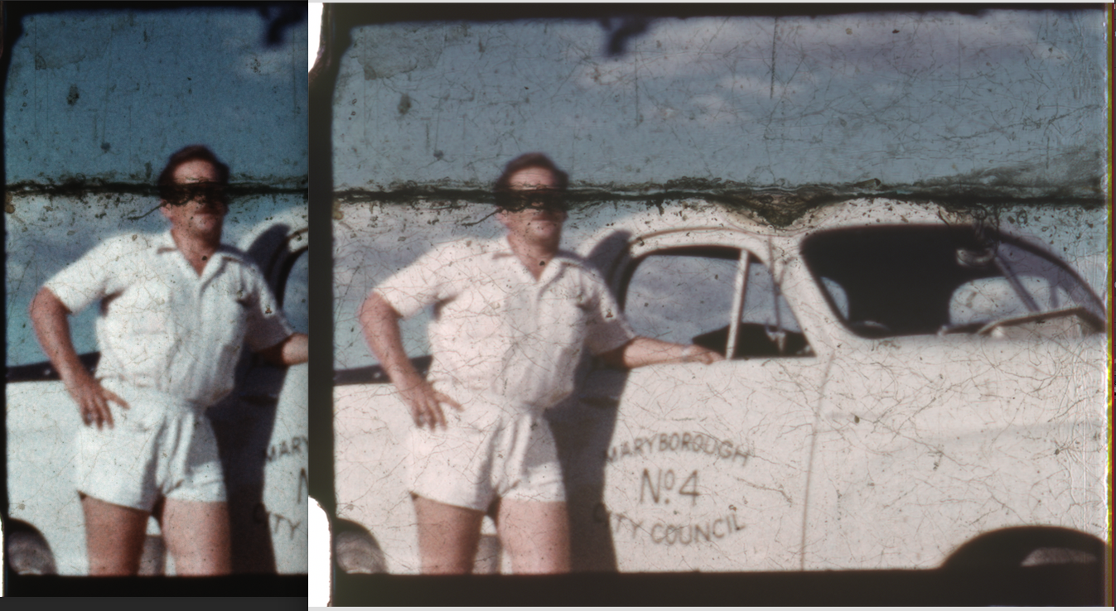

Slide 24
Tips
Invest time to find a suitable vendor with equipment
Ask other agencies for recommendations
Simple action of a snapshot to compare digitised image to physical film cell

Slide 25
Unusual Issues with Home Movies
Resourcefulness & creativity among home movie makers
Challenges for vendor:
Non-standard sound
Non-standard perforations

Slide 26
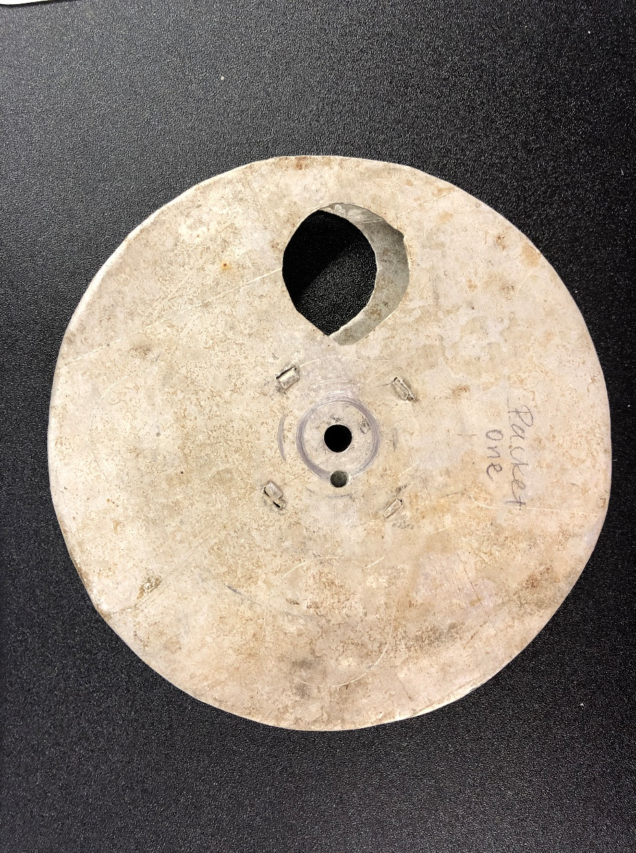
Home-made Reels

Slide 27
Mag stripes on double 16
https://www.alivestudios.co.uk/cine-film-transfer/

Slide 28
Mag stripe applied over optical track (16mm)

Slide 29
Vendor Comments
The film has both optical and mag stripe. The optical … is only visible for a short section at the end of the film…
The mag runs backwards to the vision…Audio quality of mag stripe is very poor and degrades throughout. It sounds like the mag stripe audio should run about 10fps…
Additional perforations added to this film, causing the scanner to capture an additional image per frame…

Slide 30
Additional Perfs

Slide 31
Additional Perfs - Not Uniform

Slide 32
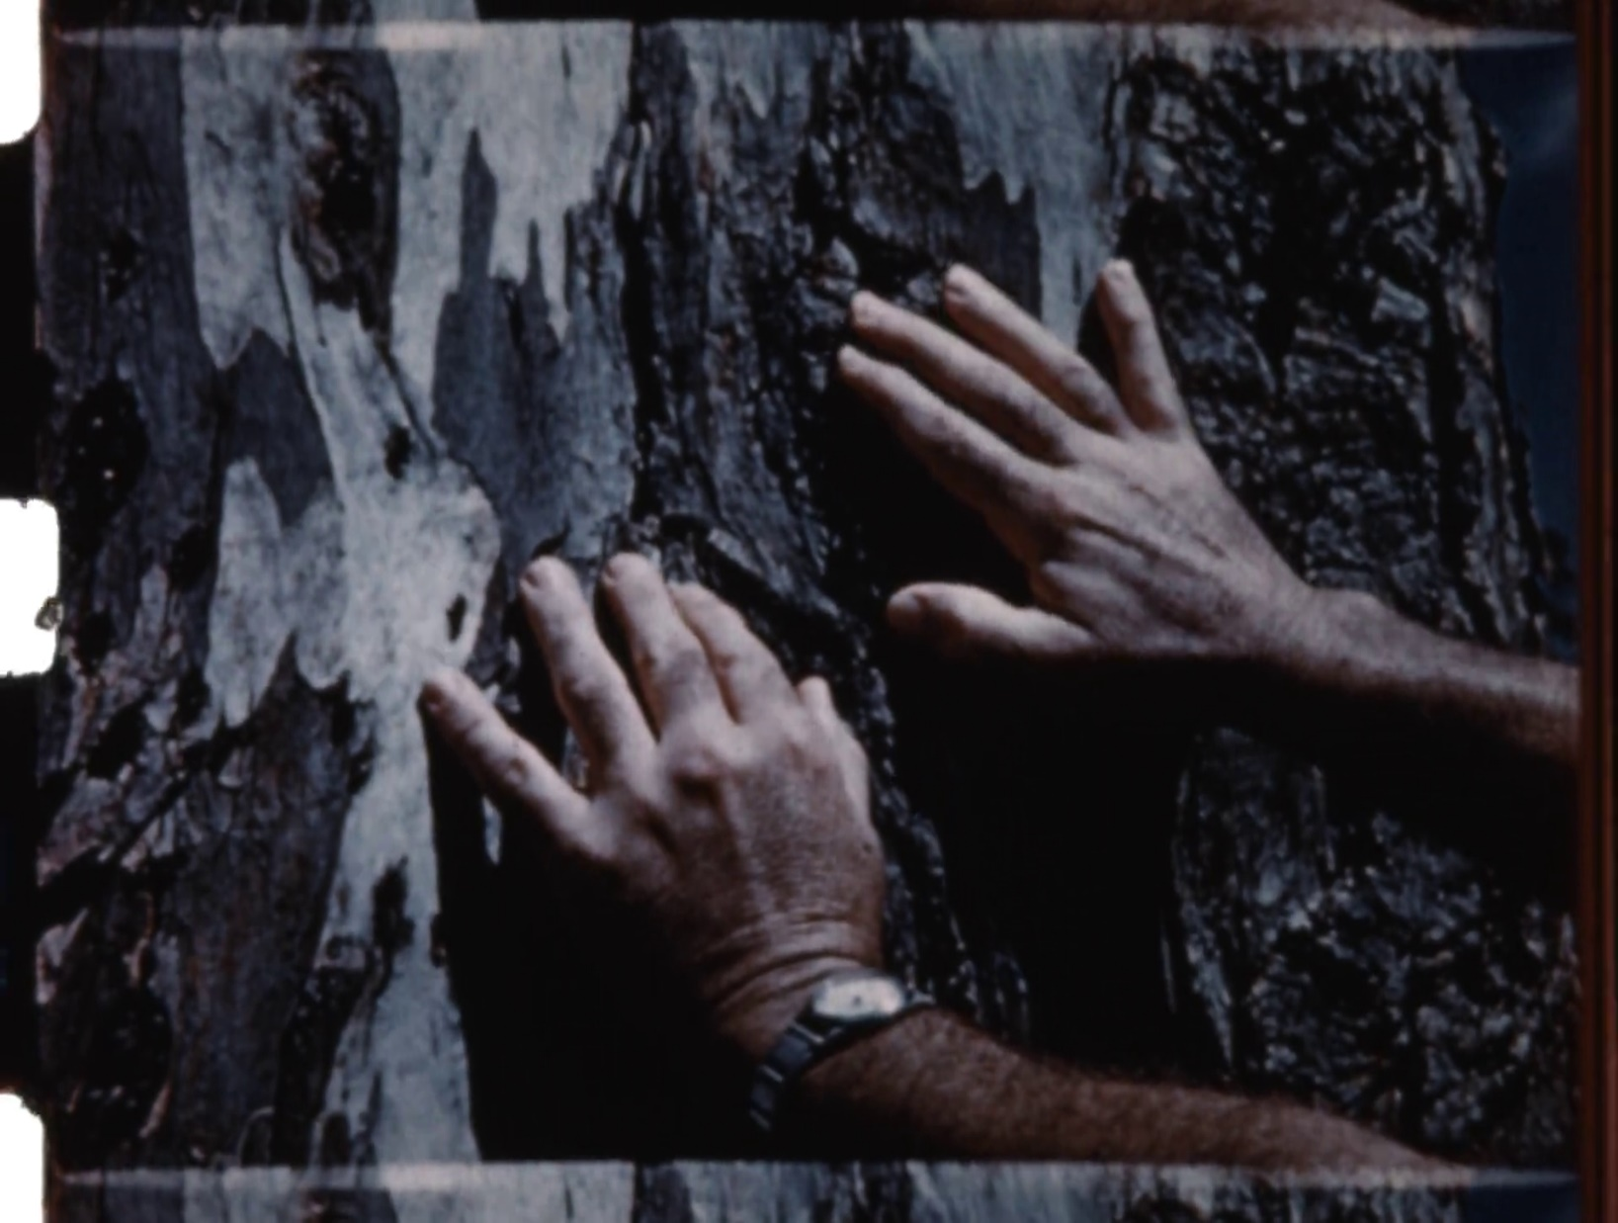
Notes:
Play video ‘32102-0020-orig_extract.mp4’ after slide32

Slide 33
Panascope 8

Slide 34
Summary to Date
About 350 films digitized
About 100 videotapes/audiotapes
Focus on magnetic media for 2021-22
Work delayed with 2020 bushfires & COVID19, for up to $40K expenditure this year

Slide 35
Other Tips - IT
Foster good working relationship with vendors and your ICTS
Decide on digital formats based on institution’s capacity & plan for data transfer time
Overestimate data storage space required
Digital preservation actions – backup, migrate, convert, fixity checks

Slide 36
More Tips
Have collection guides and video viewers developed at the same time
Expect delays from floods, bush fires, border closures, long COVID lock-downs etc
Managing expectations of Executive Team and QLD Library Foundation
Notes:
Play video ‘32102-0034-extract.mp4’ after slide 36

Slide 37
Links
https://www.slq.qld.gov.au/blog/reel-rescue
https://www.9news.com.au/national/reel-rescue-old-home-movies-a-glimpse-into-queensland-s-past/022876e5-4f38-4ba1-be8b-91143465043d
https://www.abc.net.au/news/2018-04-20/film-vault-under-state-library-preserving-states-hidden-history/9679034
https://collections.slq.qld.gov.au/guide/32102/details 32102/20 & 32102/34
State Library Digital Capture Specifications https://www.slq.qld.gov.au/sites/default/files/Digital%20capture%20specifications%202019%20-%20WEB%20VERSION.pdf

Slide 38
Swee Cheng Wong
Conservator, Audiovisual
swee.wong@slq.qld.gov.au

