Slide 1
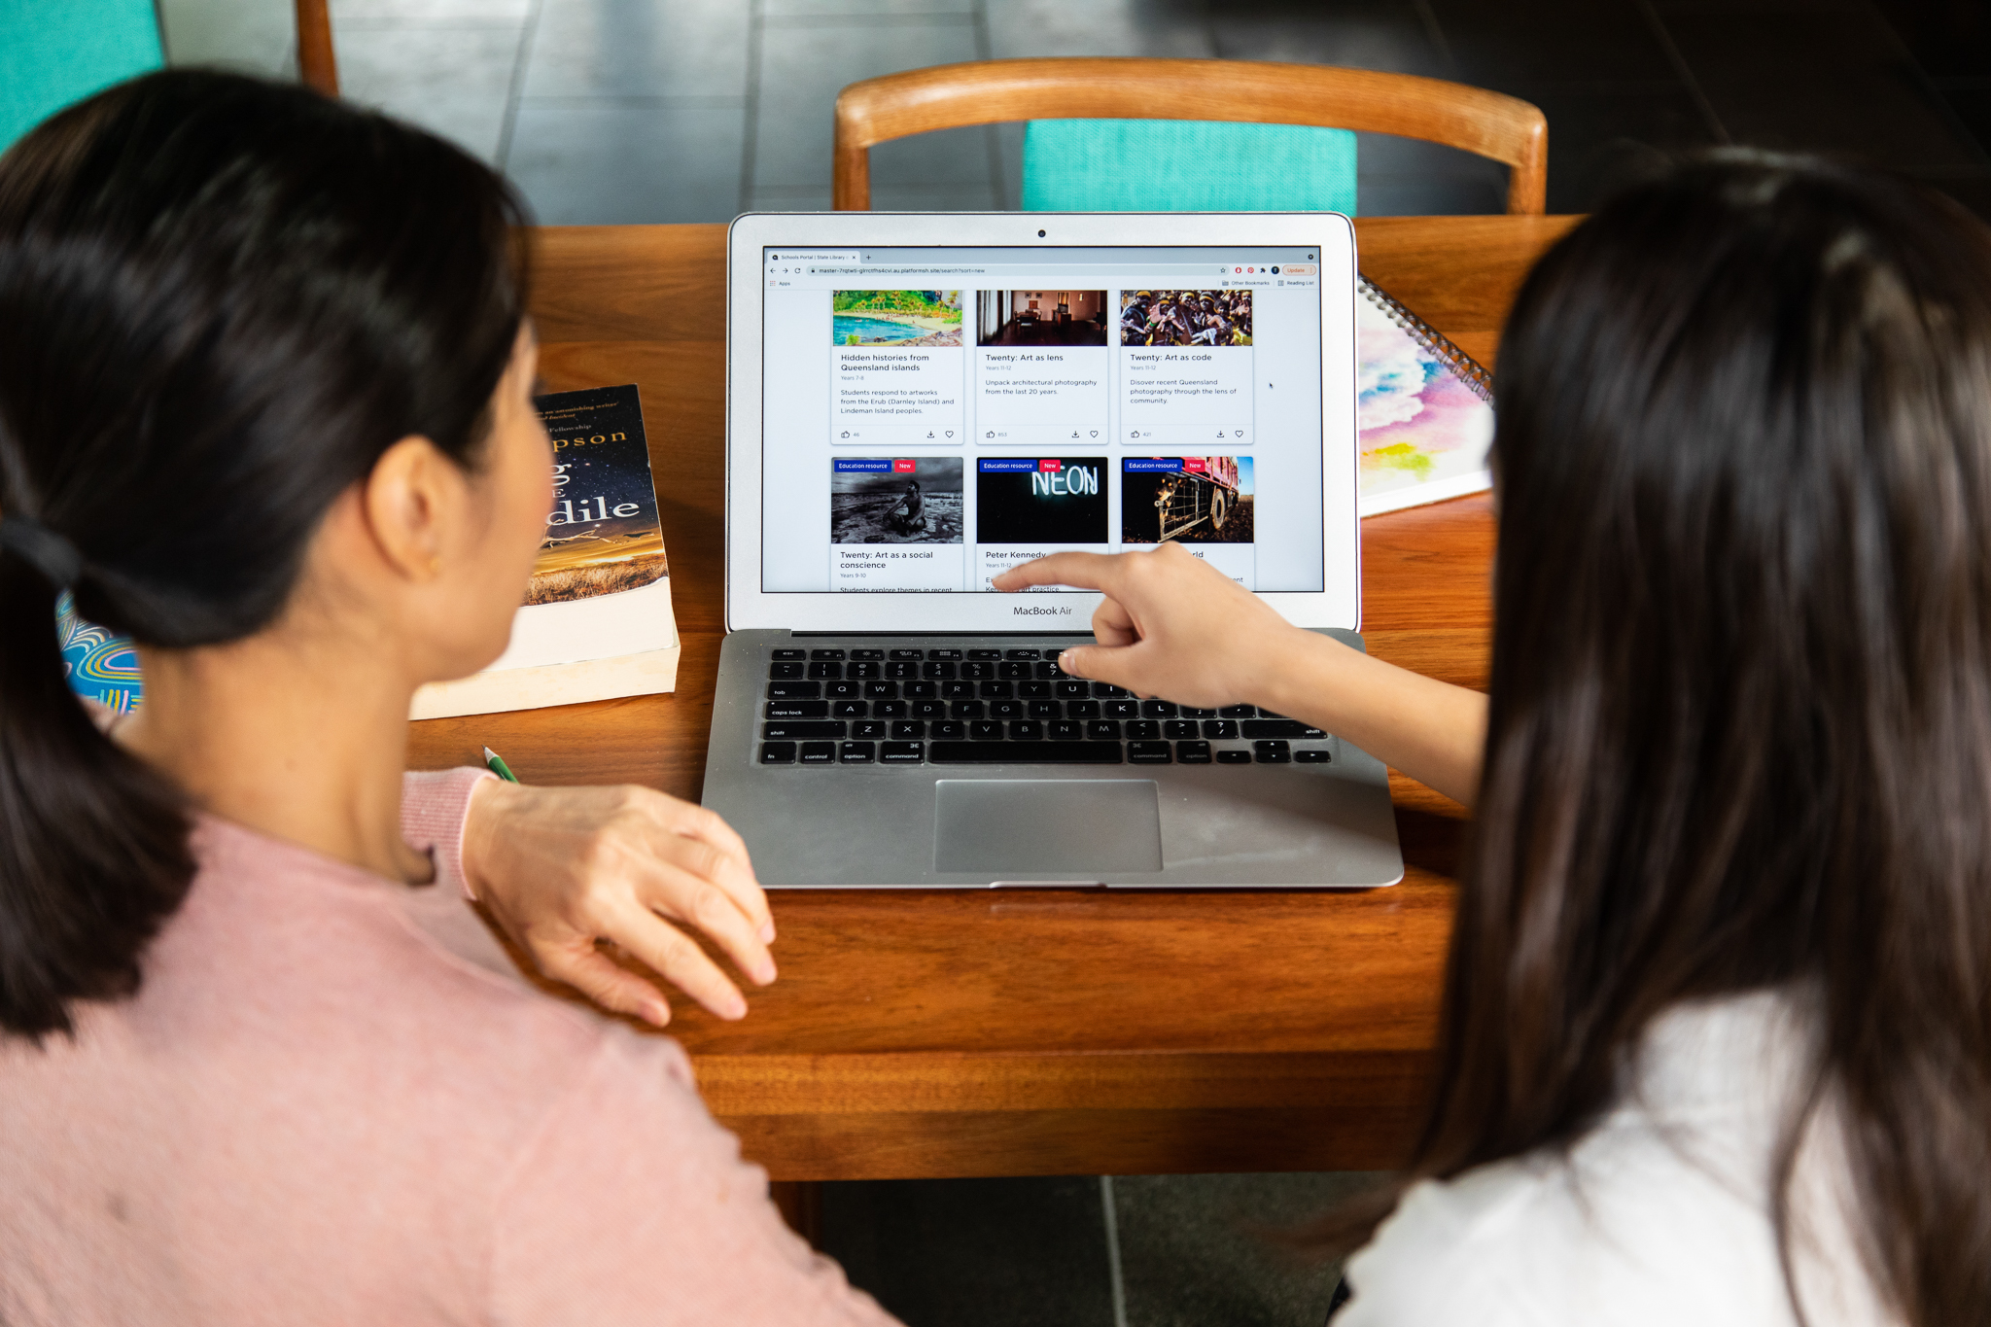
State Library of Queensland
Visual Art Stimulus Experiences: online and onsite

Slide 2
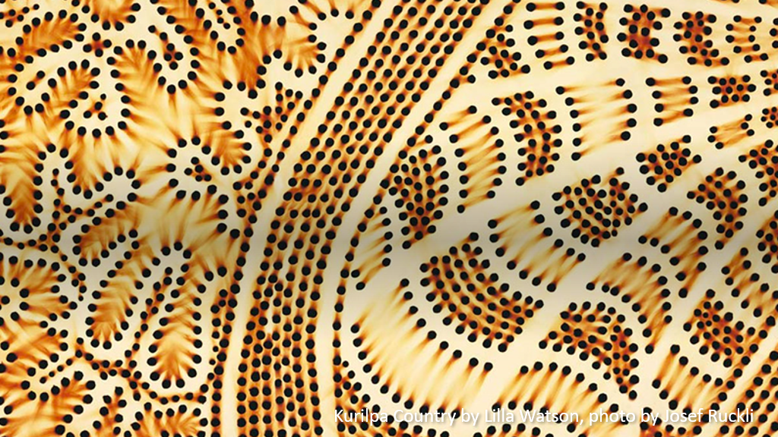
Notes:
I would like to respectfully acknowledge the traditional custodians of this land, the Yuggera, Jagera and Turrbal peoples whose stories have existed for millennia.

Slide 3
Notes:
QR code will take you to the site
Can also google Curriculum Connect
Explicit links to current curriculum
Class-room ready
Built using feedback and input from teachers, in terms of useability and contributing to content in the resources
Downloadable as Word Docs for adapting to suit own purpose and also PDFs.
Resources connect State Library’s collections of primary and secondary sources with user friendly and rigorous lesson plans, units of work or one-off activities.

Slide 4
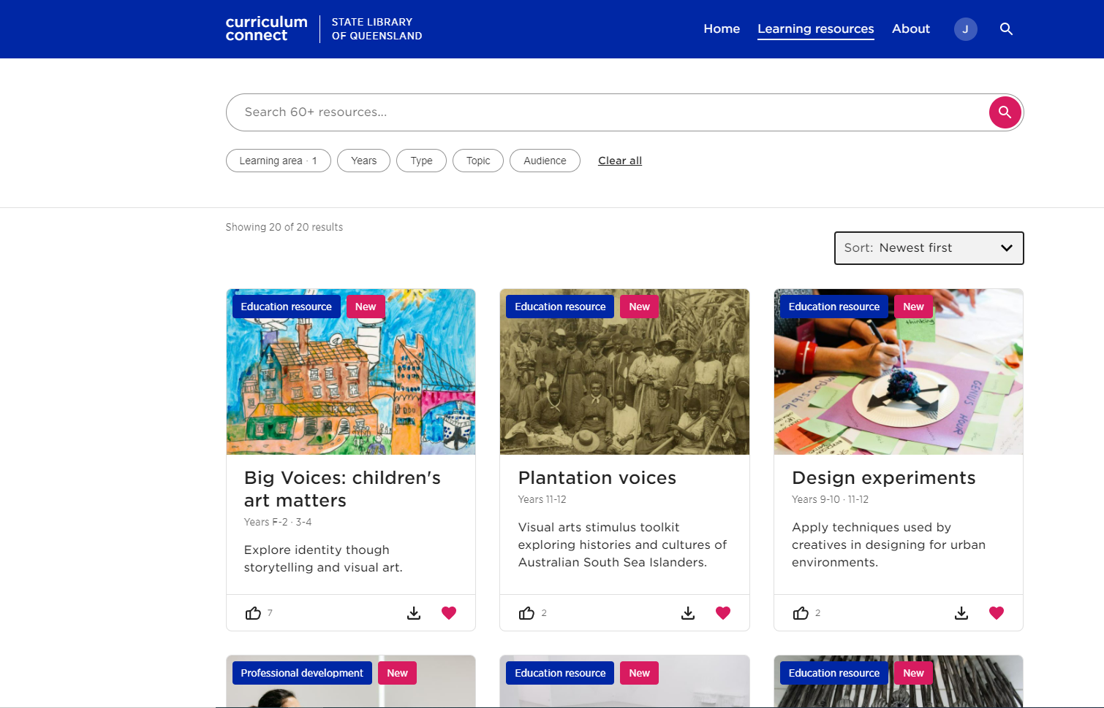
Free, on-line teaching resources
Notes:
Built on two pillars: first nations and Queensland stories
1. The first is Aboriginal and Torres Strait Islander culture and stories – sharing First Nations perspectives and building the capability of teachers delivering this content.
2. Queensland stories – bringing interpretations of Queensland’s past and contemporary life into the classroom, ensuring students can connect to content that reflects their world and experiences

Slide 5
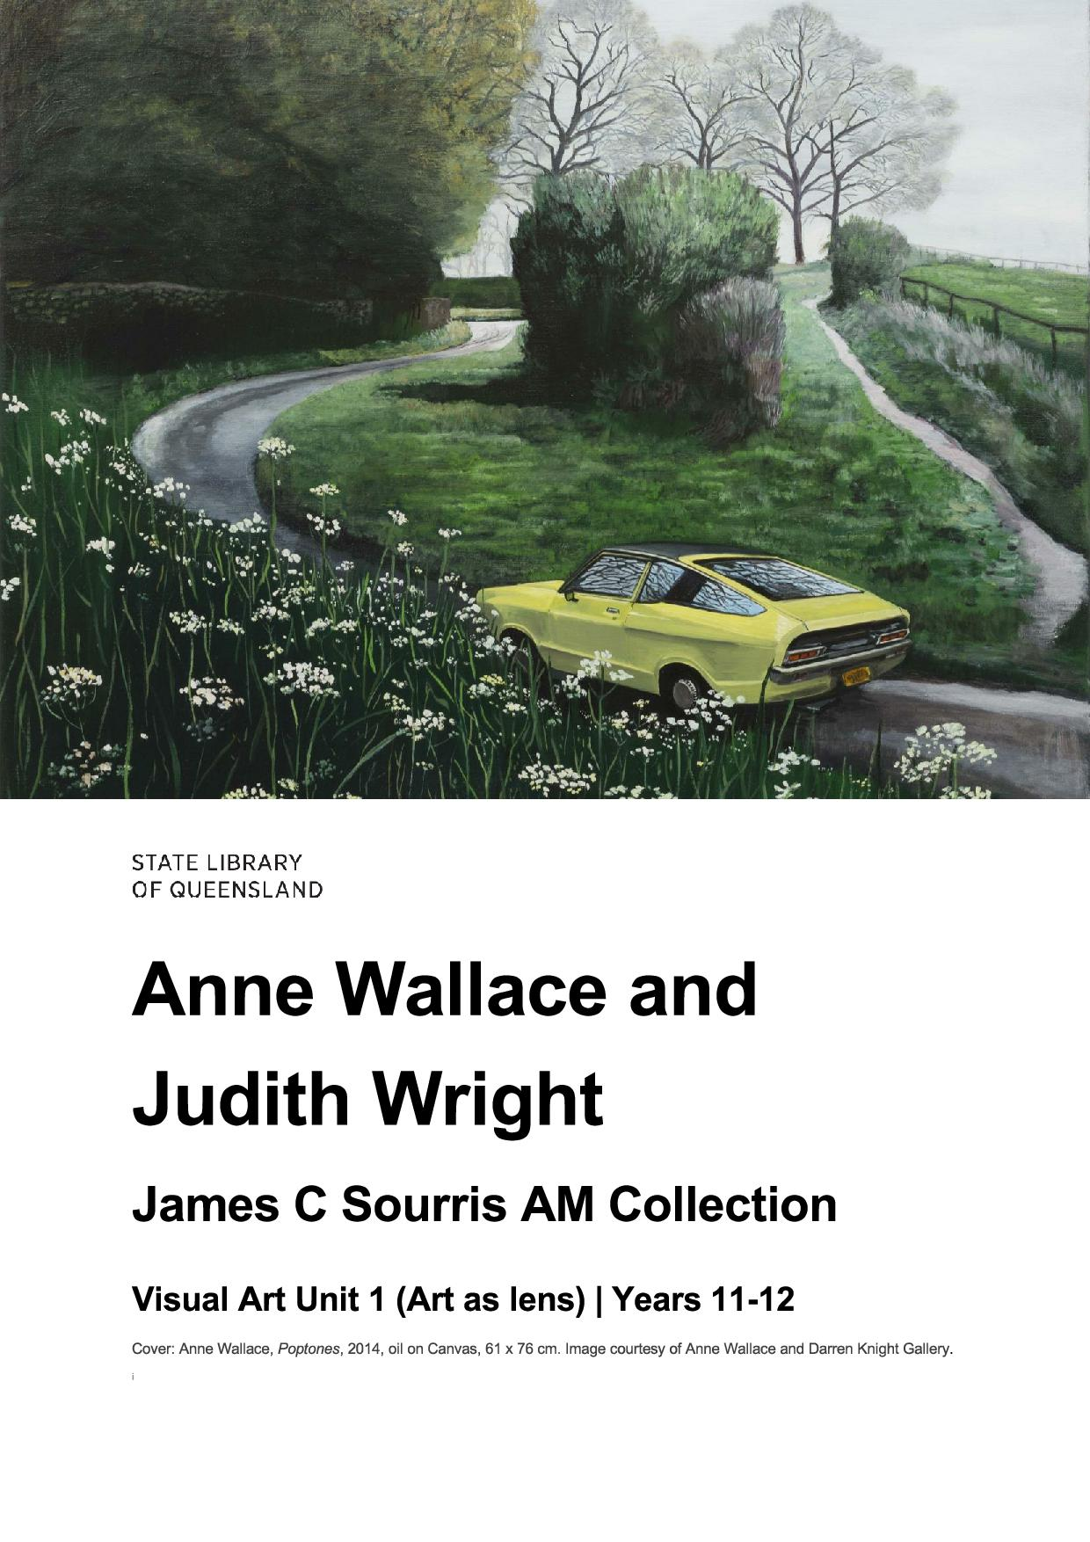
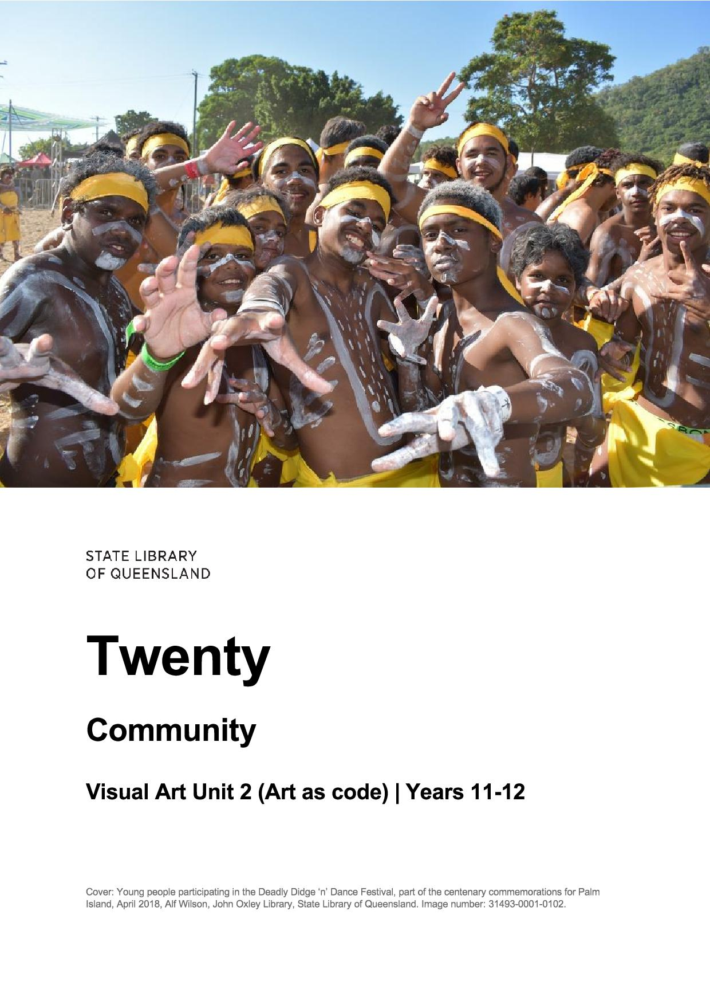
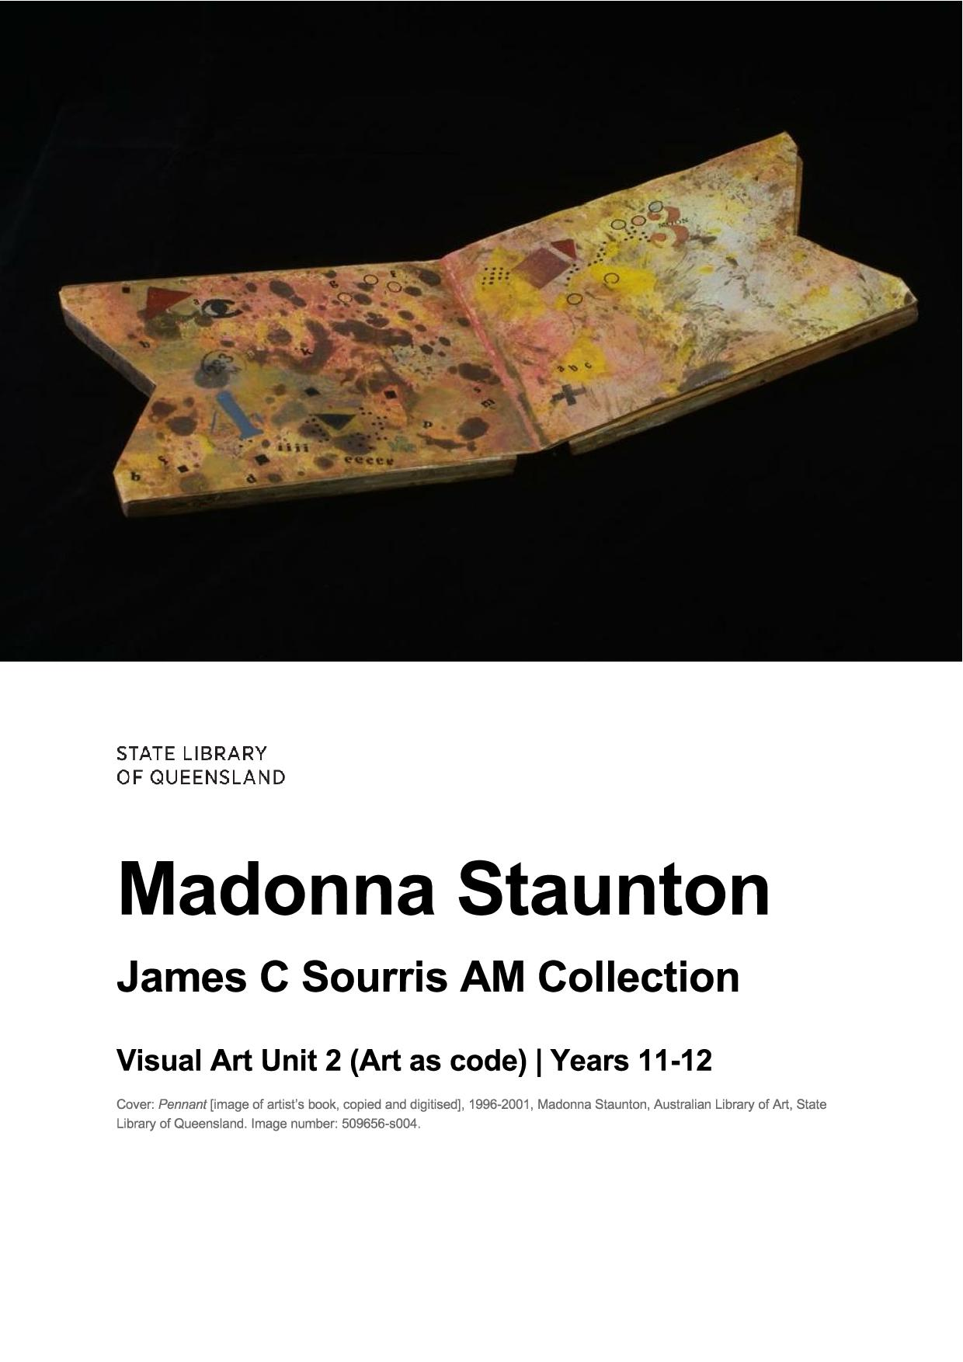
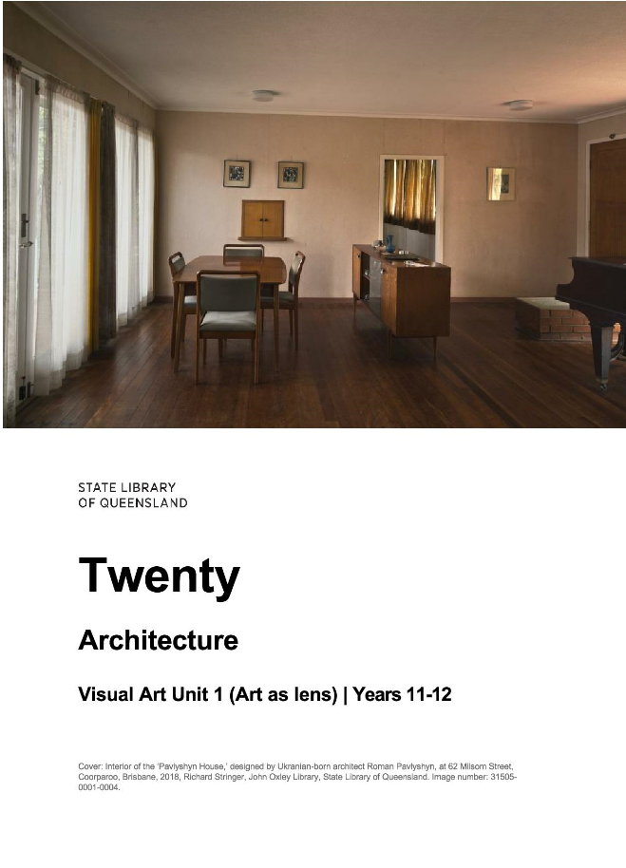
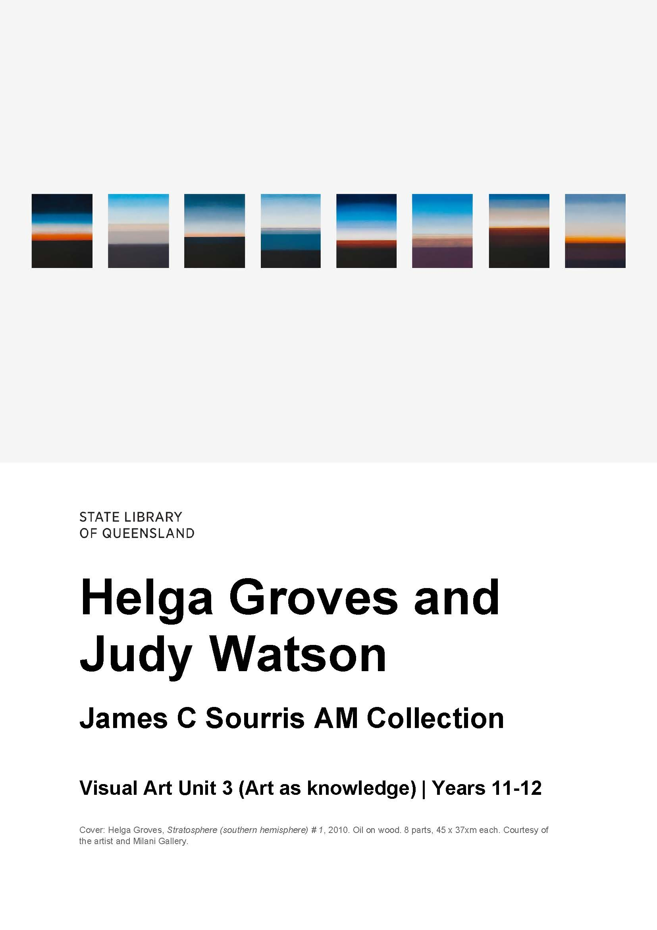
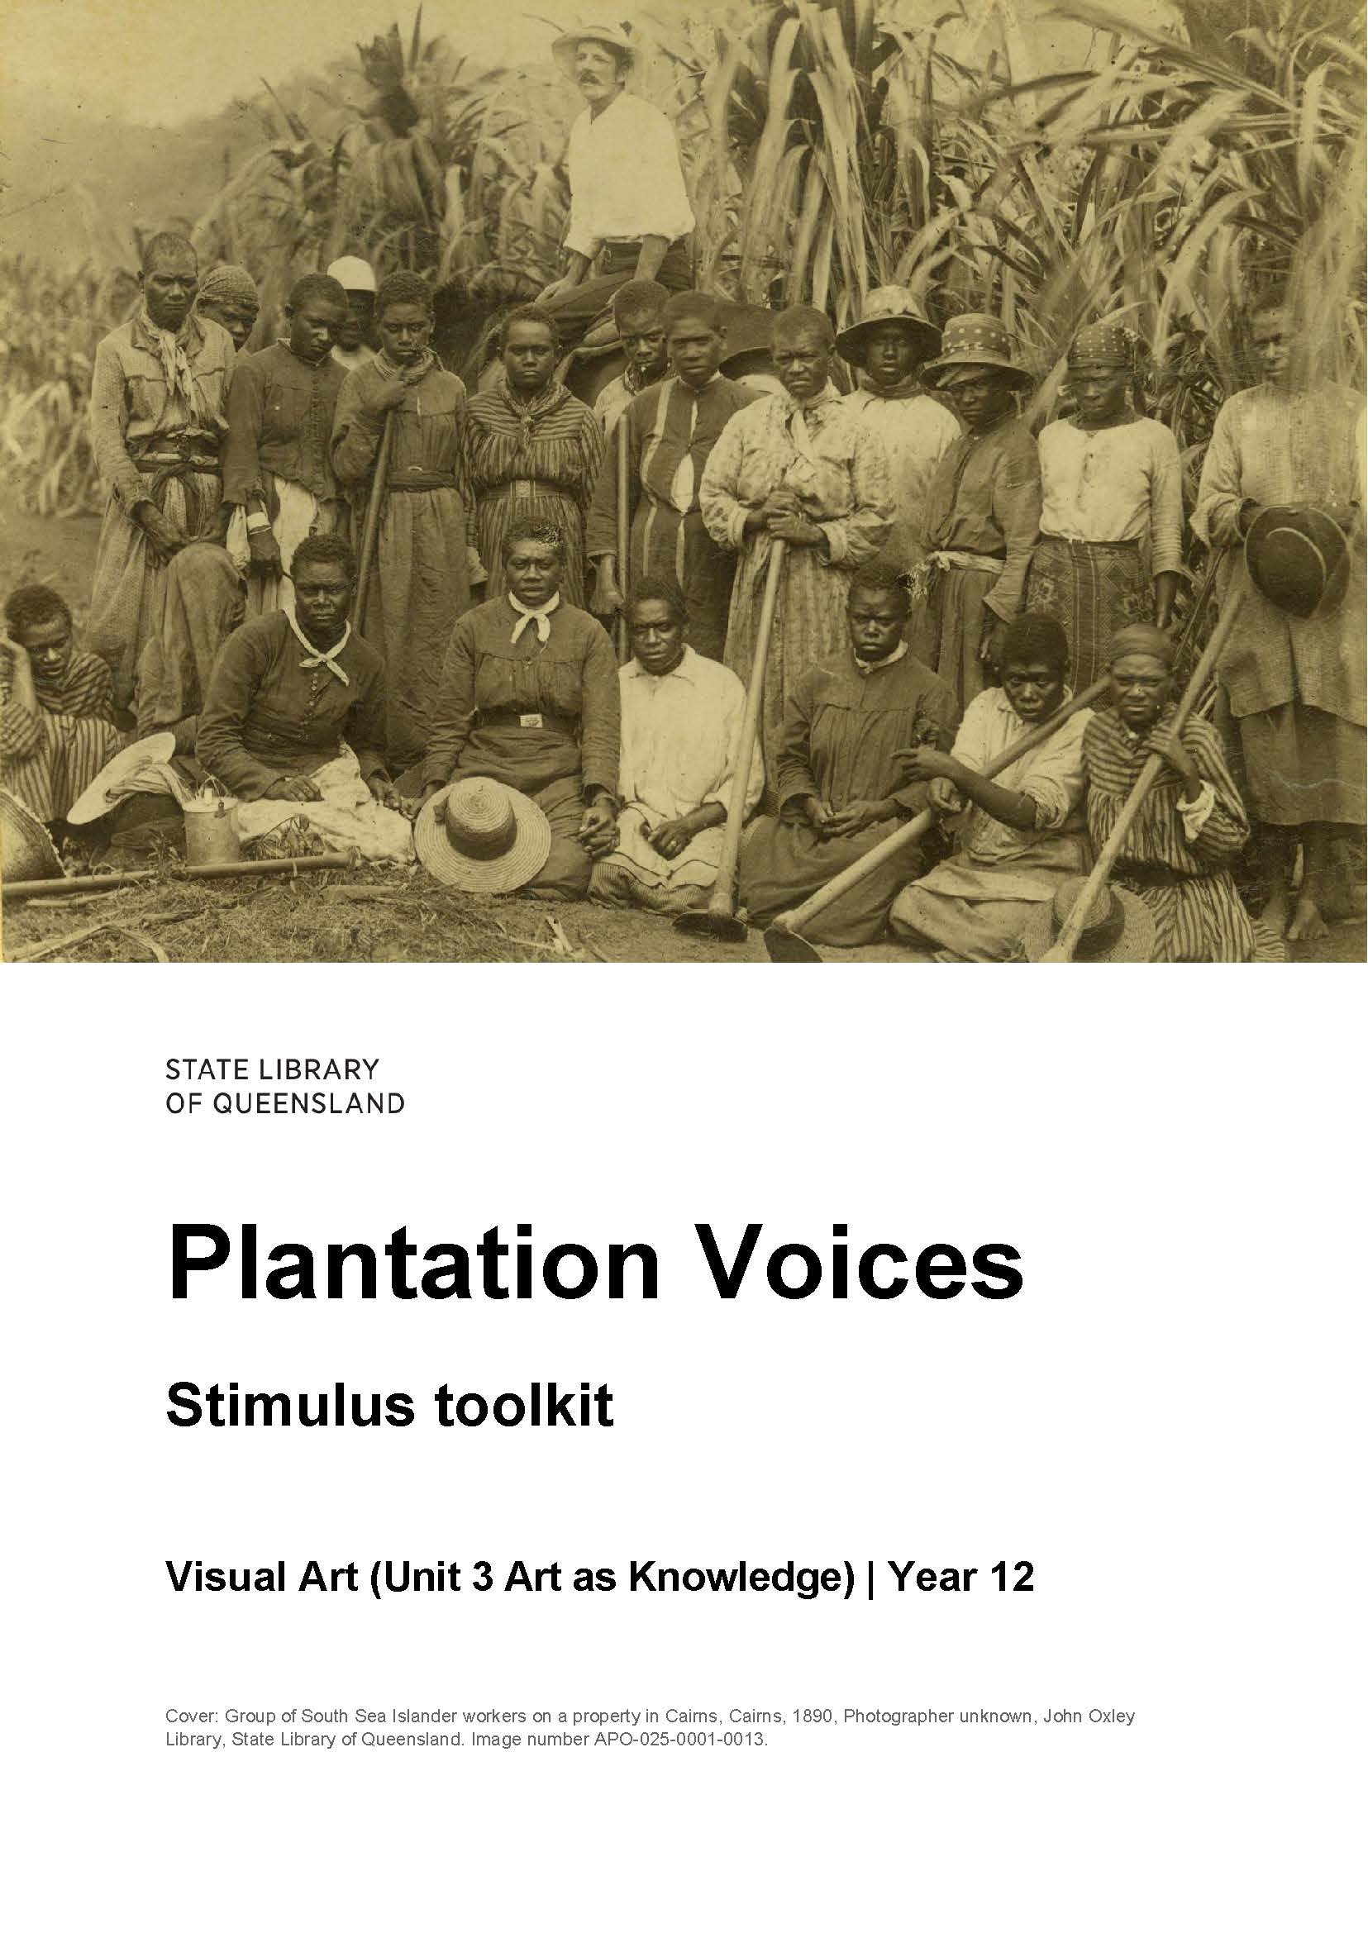
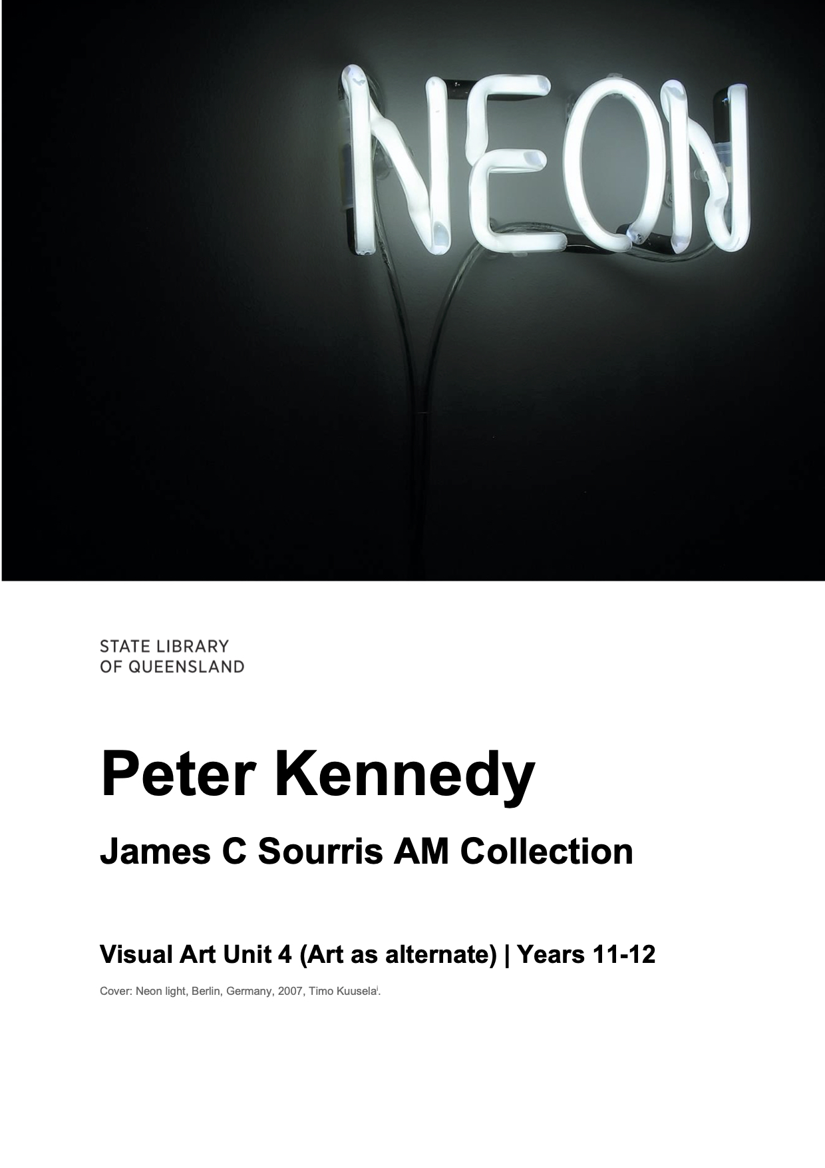
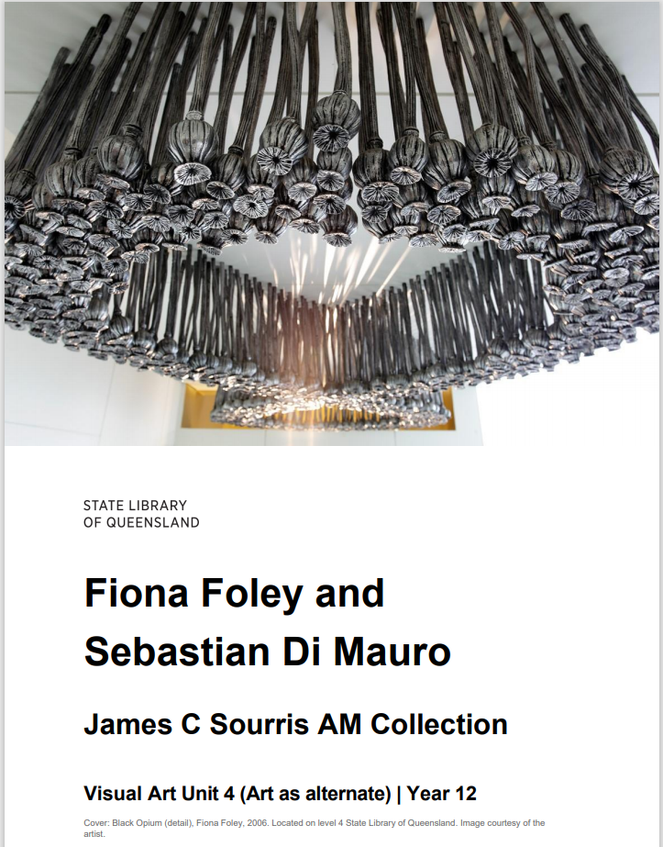
Notes:
Currently we have 20 for Visual Art uploaded
Senior ones here –
Built around the subject matter, objectives and valued pedagogies of the Senior Secondary Visual Art Curriculum.
Units of work for units 1-4 . very thorough

Slide 6
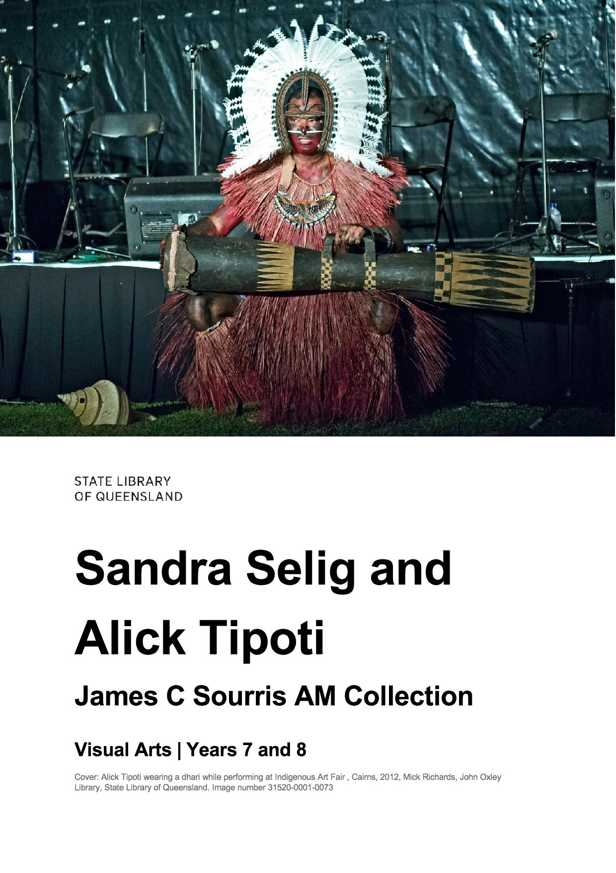
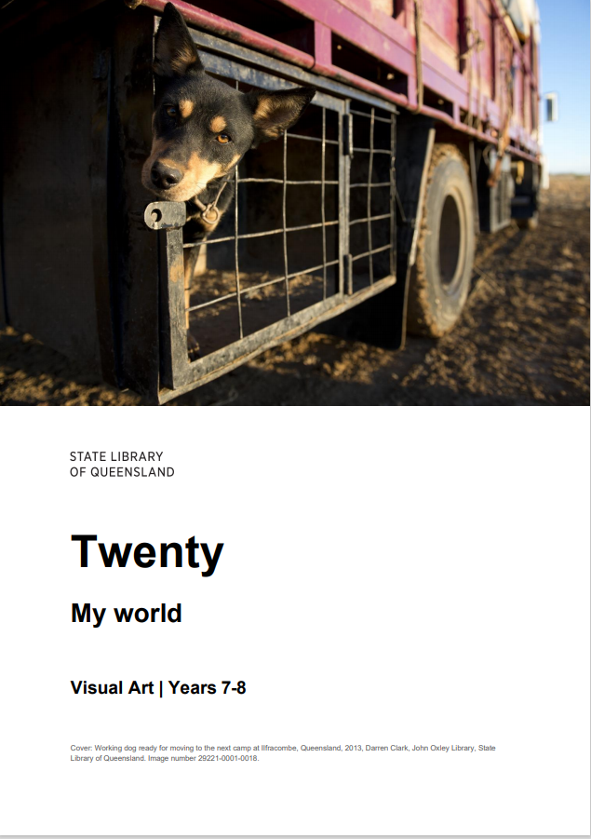
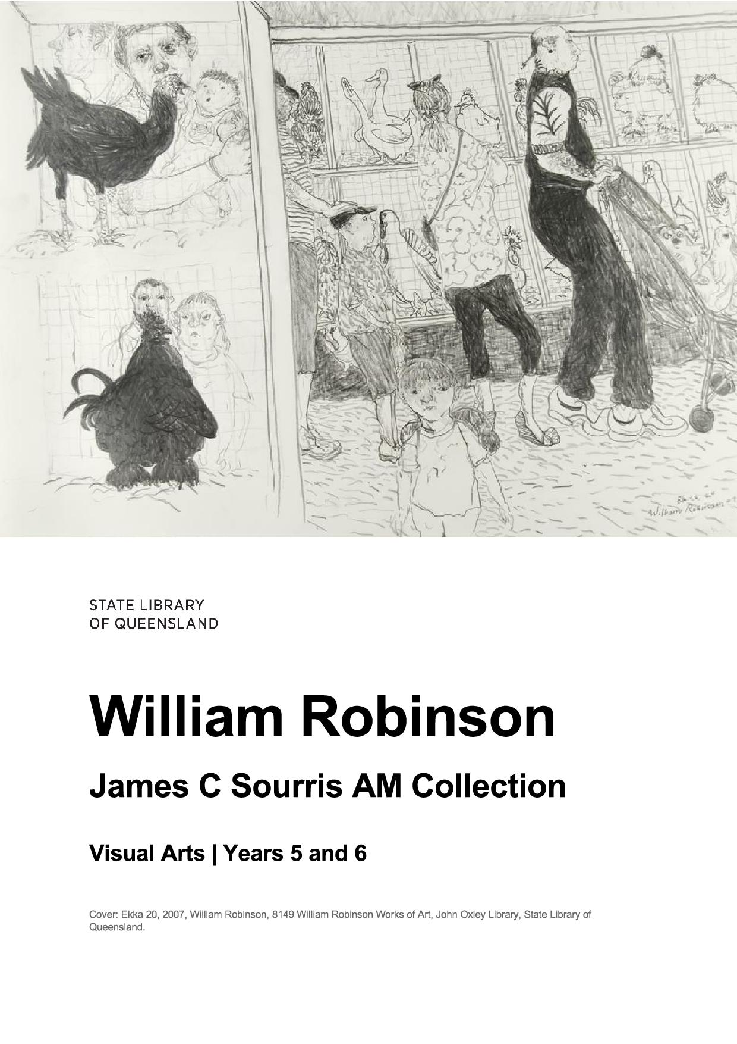
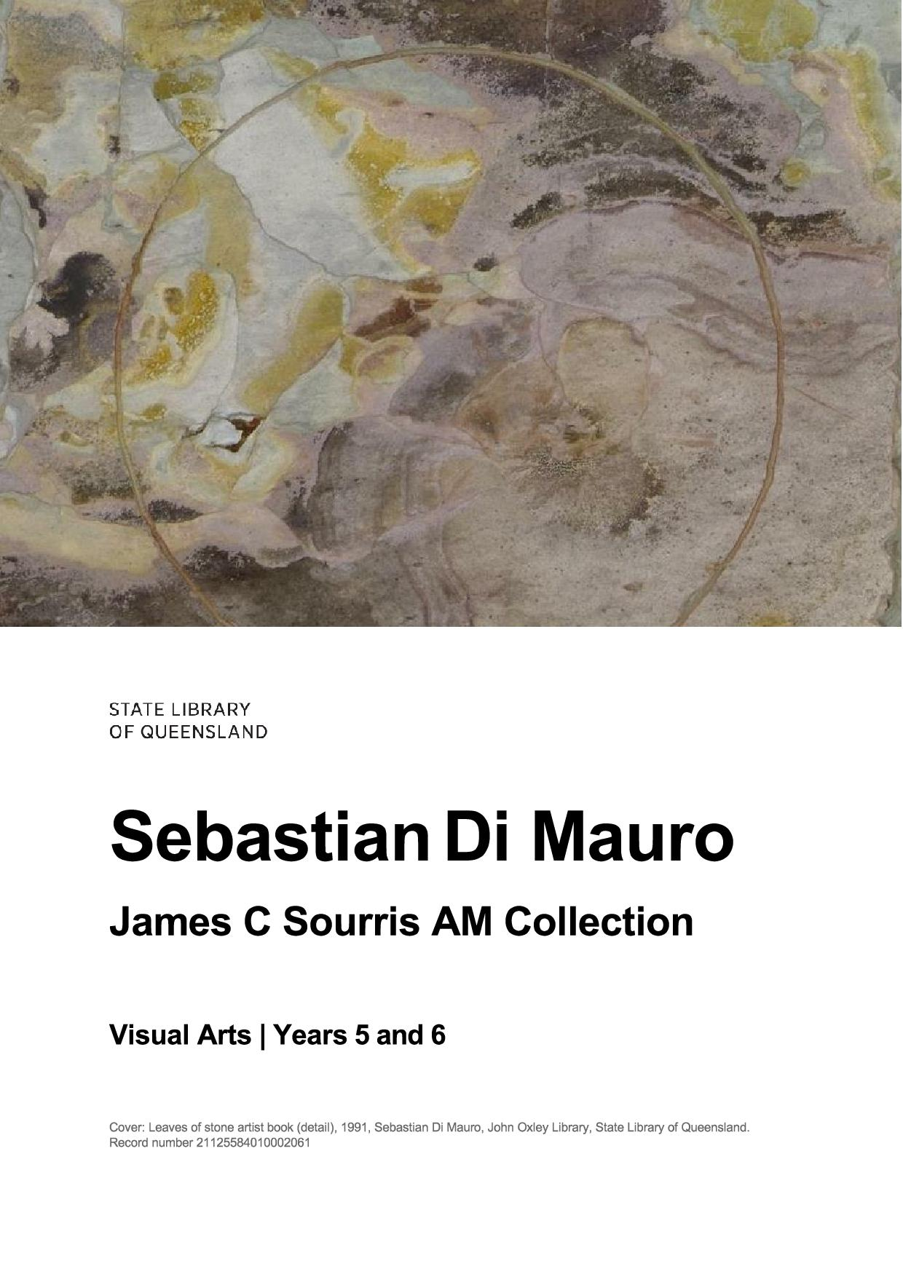
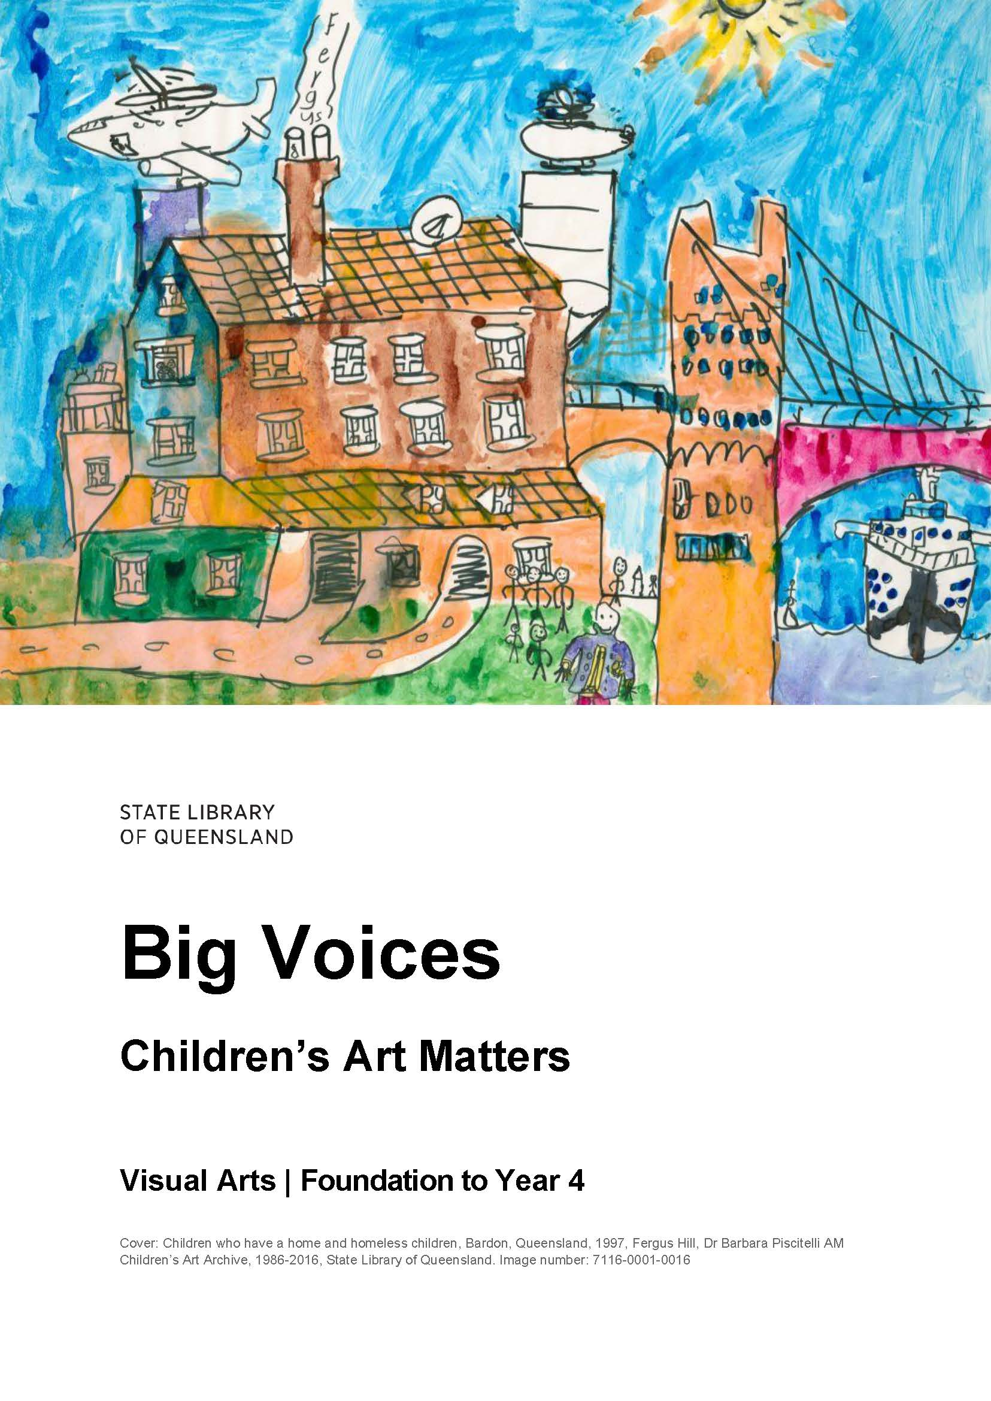
Notes:
Australian Curriculum linked resources for P-10
These include
Big Voices resource that supports early years teachers to facilitate portraiture workshops in their classrooms.
Upper primary resources – William Robinson and Sebastian Di Mauro- revolving around the James C Sourris videos
Several resources for Years 7-10.
Cross curriculum Resources such as this Design Minds resource which includes design and technology 9-10 as well as Visual Art 9-12 links

Slide 7
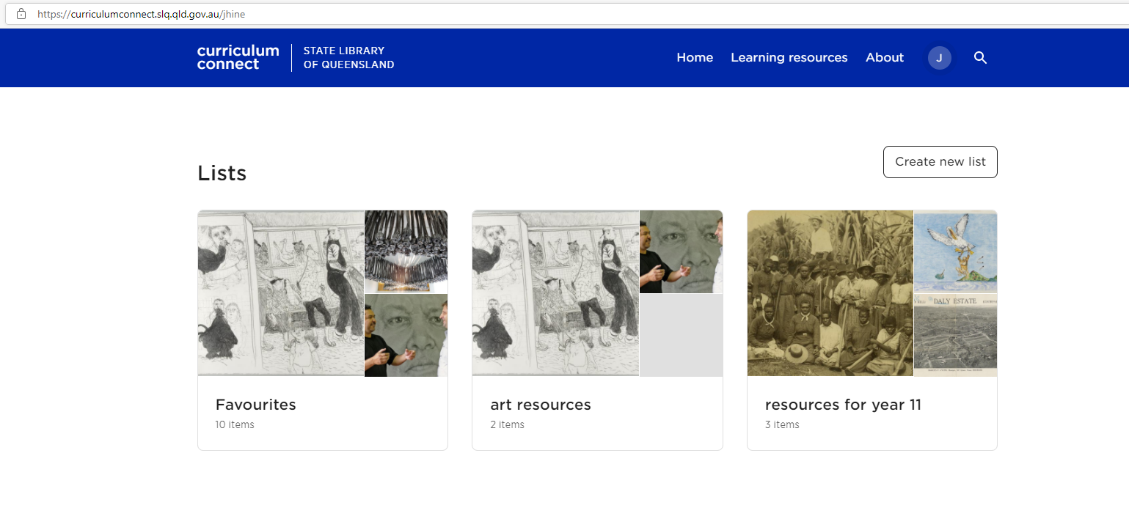
Notes:
Become a State Library Member so you can take advantage of saving sharing and collaborating

Slide 8
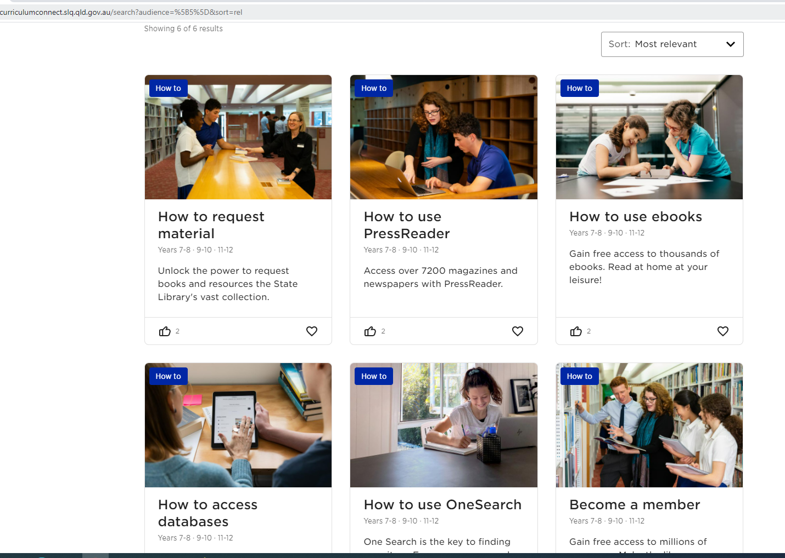
Information literacy resources for students
How-to videos
Notes:
To help your students use library resources.

Slide 9
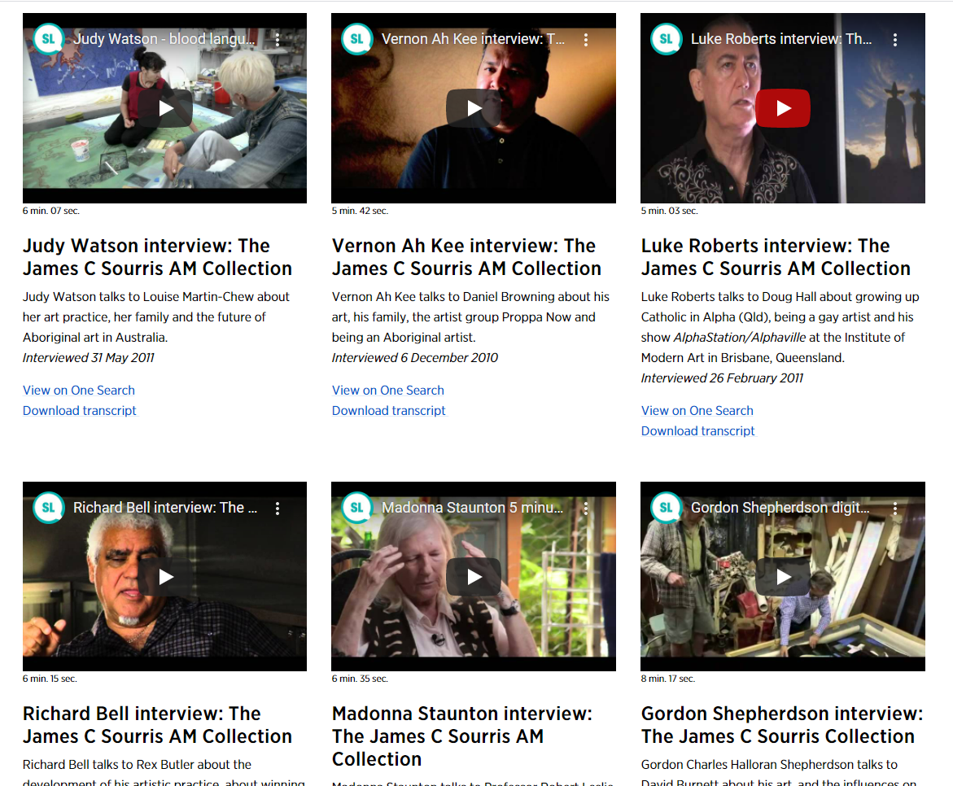
State Library collection highlights as in-school
stimulus experiences
James C Sourris AM Collection
James C Sourris A M Collection
Notes:
10 of the Education resources on Curriculum Connect directly link to James C Sourris Collection of artists videos .
James C Sourris AM is a long-time supporter and friend to many in the Queensland cultural community. His enthusiasm for contemporary Australian art and artists is evidenced through his private collection and the James C Sourris AM Collection of Artist Interviews held by State Library of Queensland.
These interviews, provide an insight into the motivations, inspirations and tribulations of some of Australia’s most acclaimed visual creatives and enable research, student learning and personal enjoyment. There are three versions of each interview available - short (under 10 minutes), medium (approximately 30 minutes) and long-form (1hr+).
View from anywhere in Queensland
https://www.slq.qld.gov.au/research-collections/art-and-design/james-c-sourris-am-collection

Slide 10
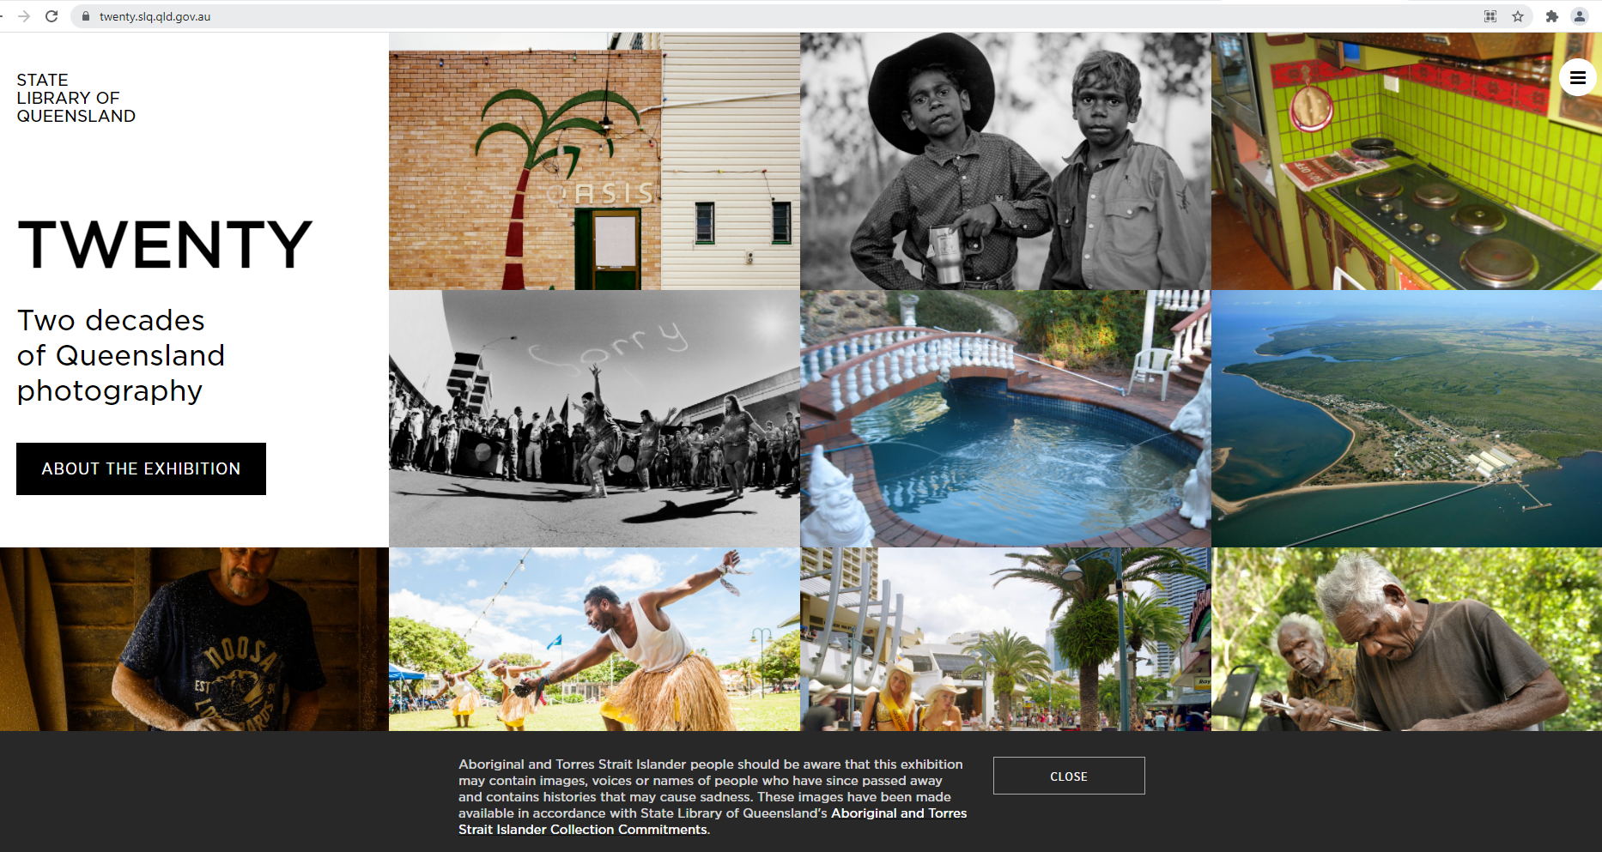
State Library collection highlights as in-school
stimulus experiences
Twenty
Two Decades of Queensland
Photography
online Exhibition
https://twenty.slq.qld.gov.au/
Notes:
Resources for Twenty: Two decades of Qld Photography
Is an online exhibition
Curriculum Connect has 4 resources for this exhibition- For Yrs 11 and 12 art as lens, art as code, year 7-8 and years 9-10

Slide 11
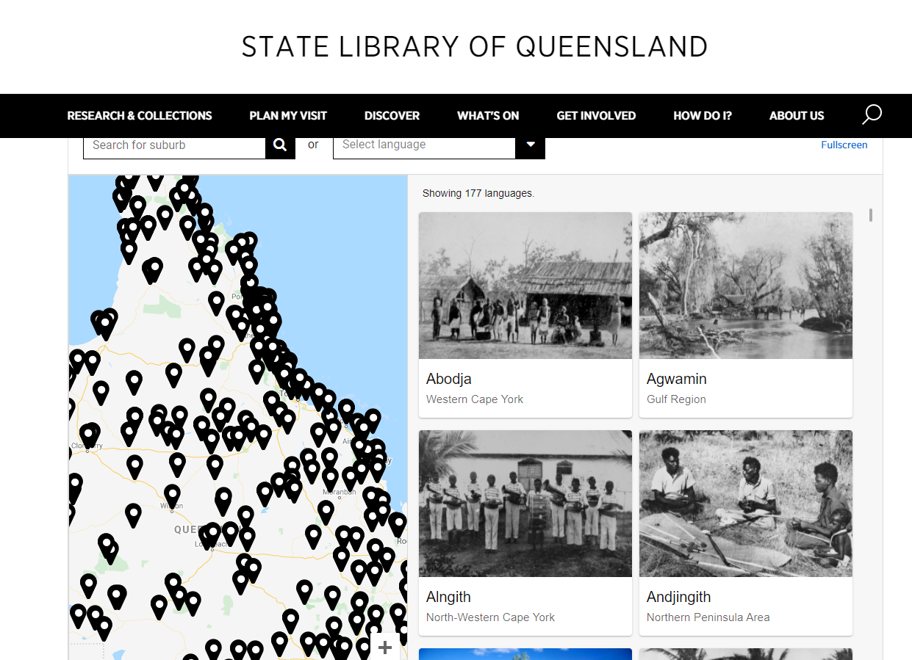
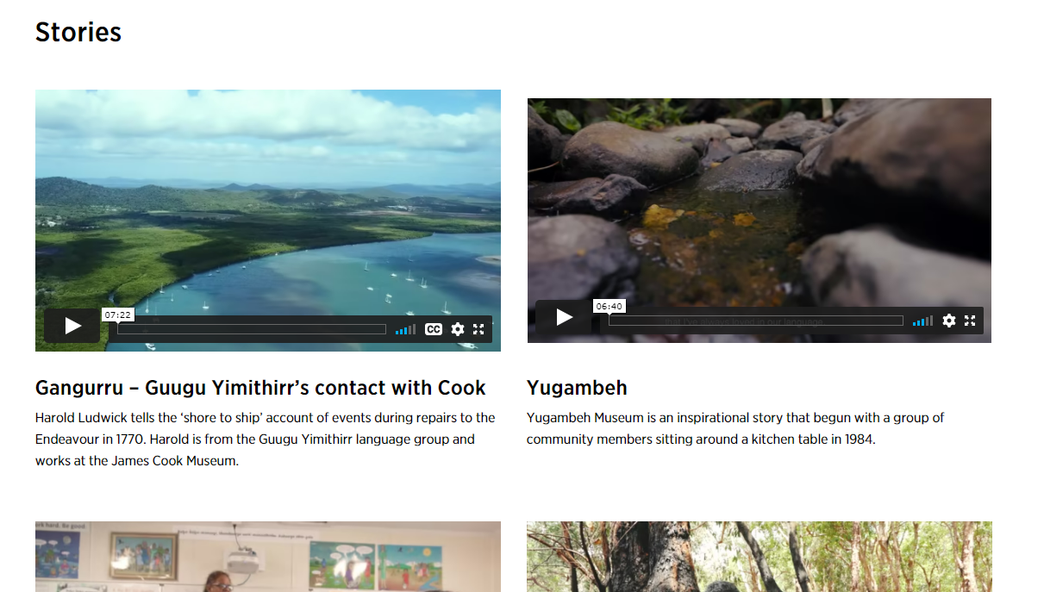
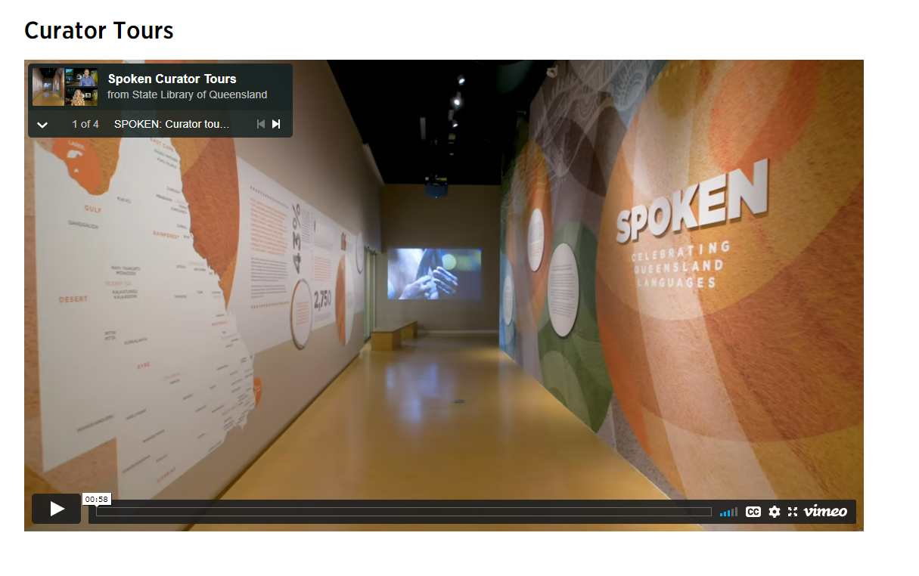
State Library collection highlights as in-school
stimulus experiences
Spoken online Exhibition and Indigenous languages interactive map https://www.slq.qld.gov.au/spoken
Notes:
Spoken
Amazing resource- stimulus experience in a neat package
Has a virtual tour of the Spoken exhibition that was held onsite in 2018
Videos of the curators talks
Digital interactive that will provide the name of the local First Nations people and their language, and examples of key vocab
7 Short videos of language speakers talking about the importance of preserving languages
Powerful.

Slide 12
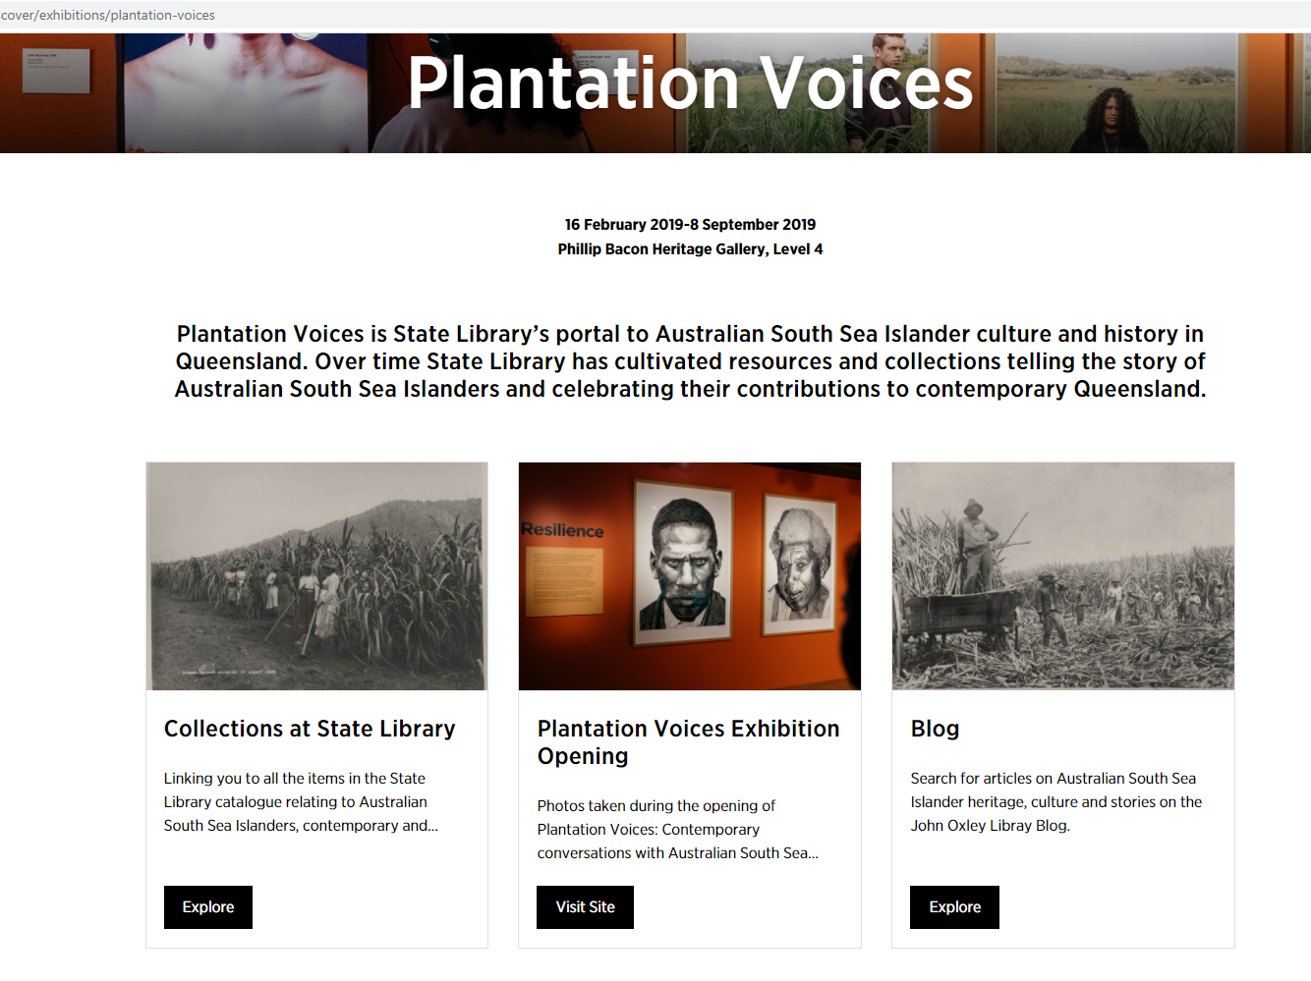
State Library collection highlights as in-school
stimulus experiences
Plantation Voices
https://www.slq.qld.gov.au/whats-on/plantation-voices
Notes:
Plantation Voices is State Library’s portal to Australian South Sea Islander culture and history in Queensland. Over time State Library has cultivated resources and collections telling the story of Australian South Sea Islanders and celebrating their contributions to contemporary Queensland.
Curriculum Connect new resource built as stimulus toolkit to explore the experiences of South Sea islanders.
Series of activities that explore the topic

Slide 13
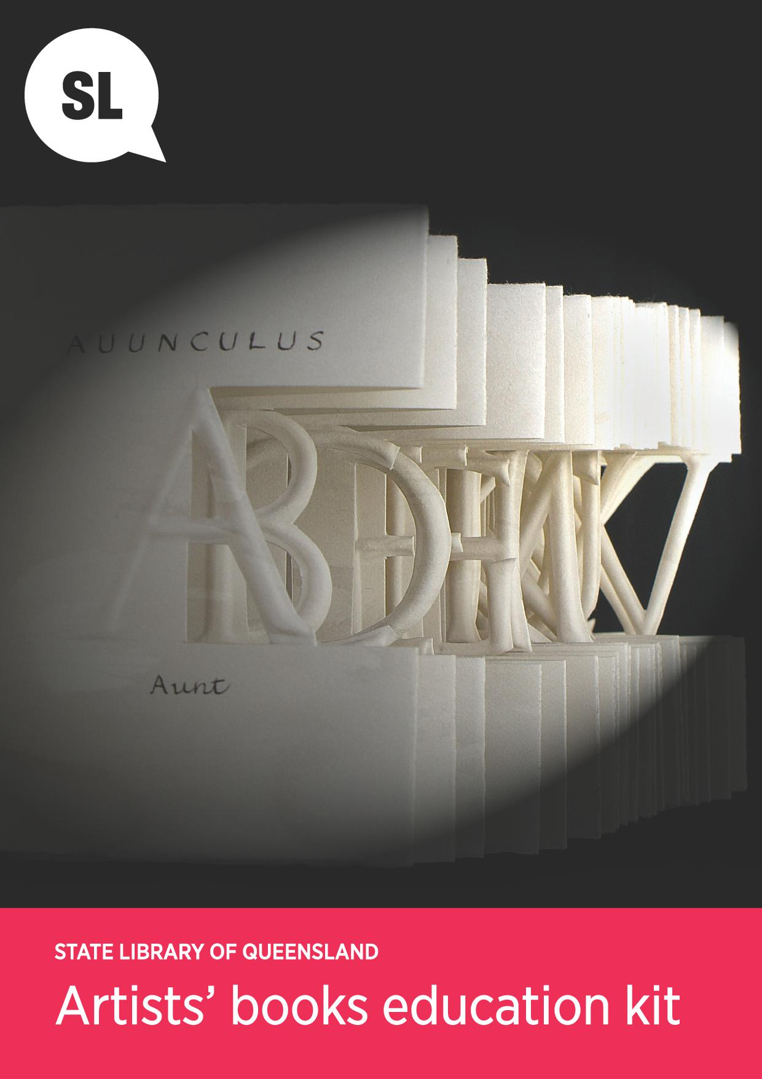
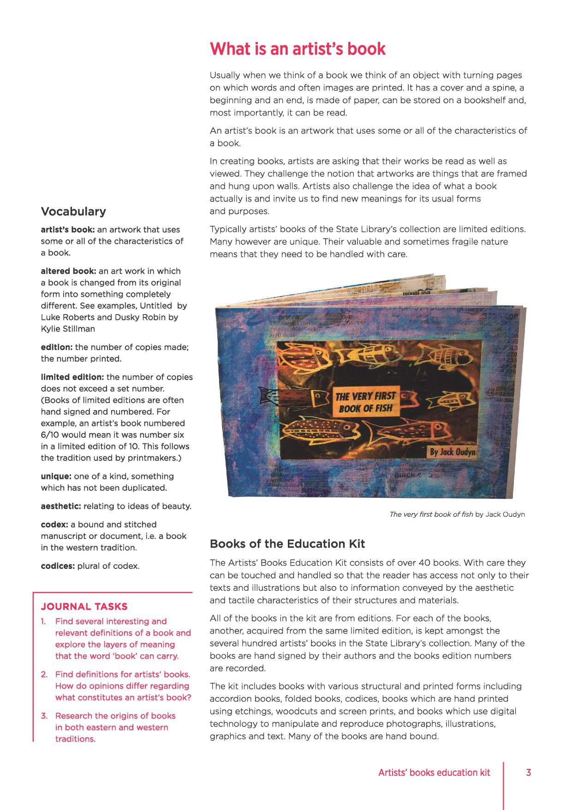
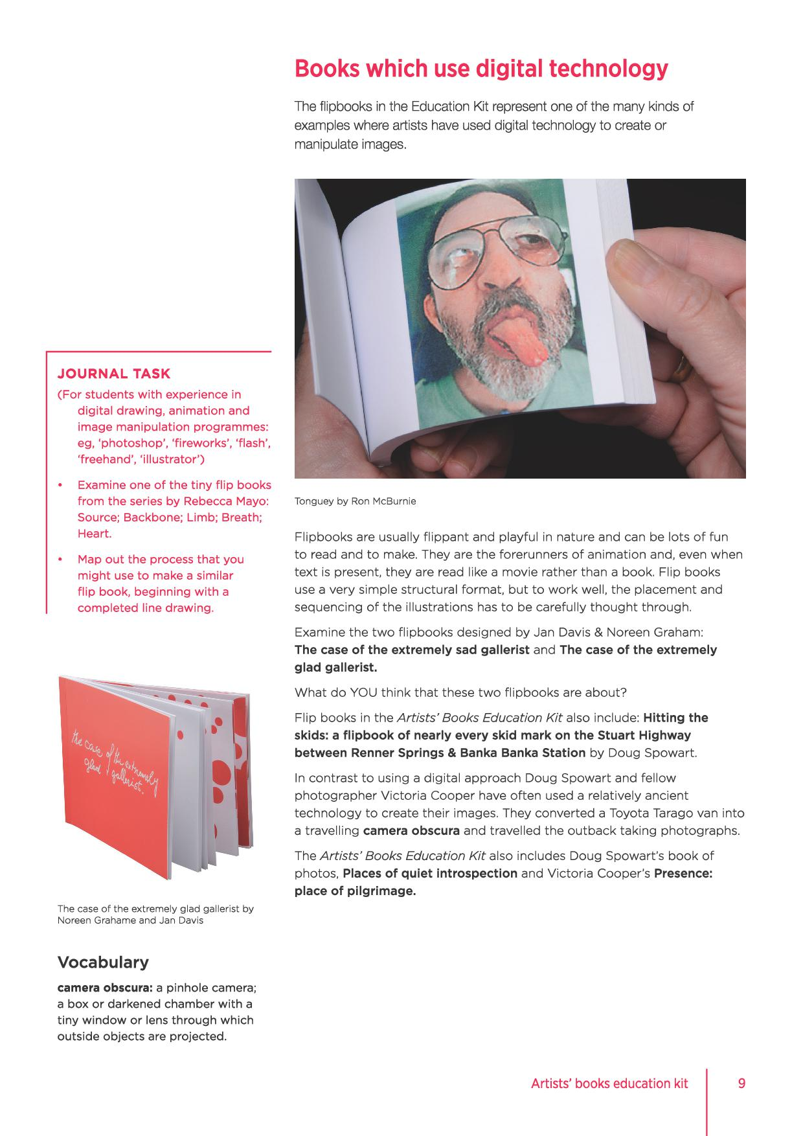
Notes:
Very rich resource to assist with artists books . Can be downloaded from Curriculum Connect.

Slide 14
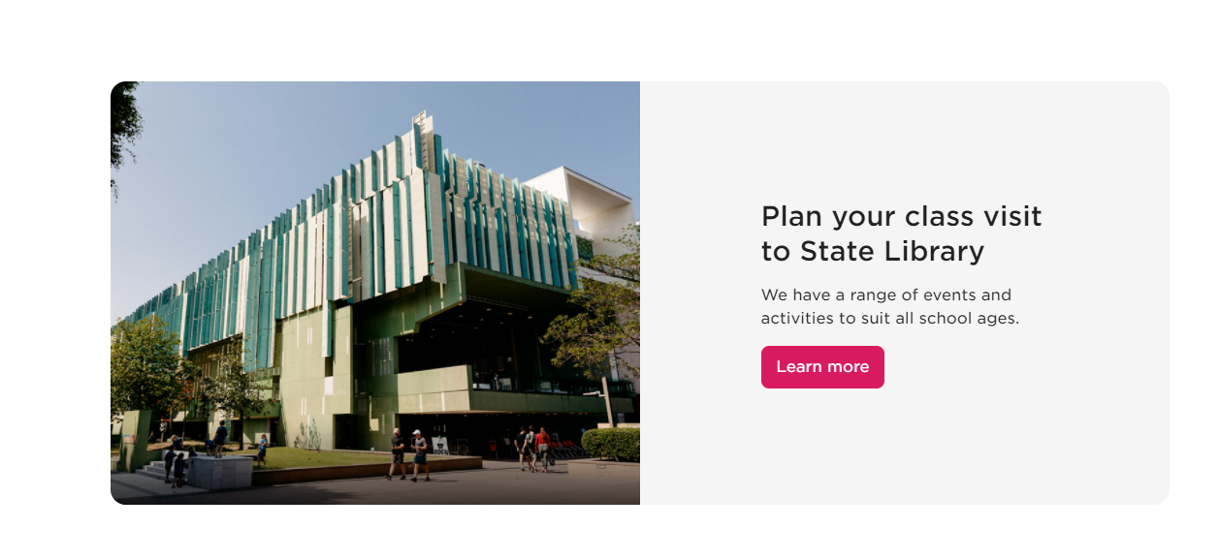
Book a school visit to State Library through Curriculum Connect
https://www.slq.qld.gov.au/school-visits
Notes:
https://www.slq.qld.gov.au/school-visits
5 different onsite offers plus ANZAC Square.
New offer coming in Term 4 Art in Public Spaces – self guided tour of three key First Nations works that tie to eth architecture of the building.

Slide 15
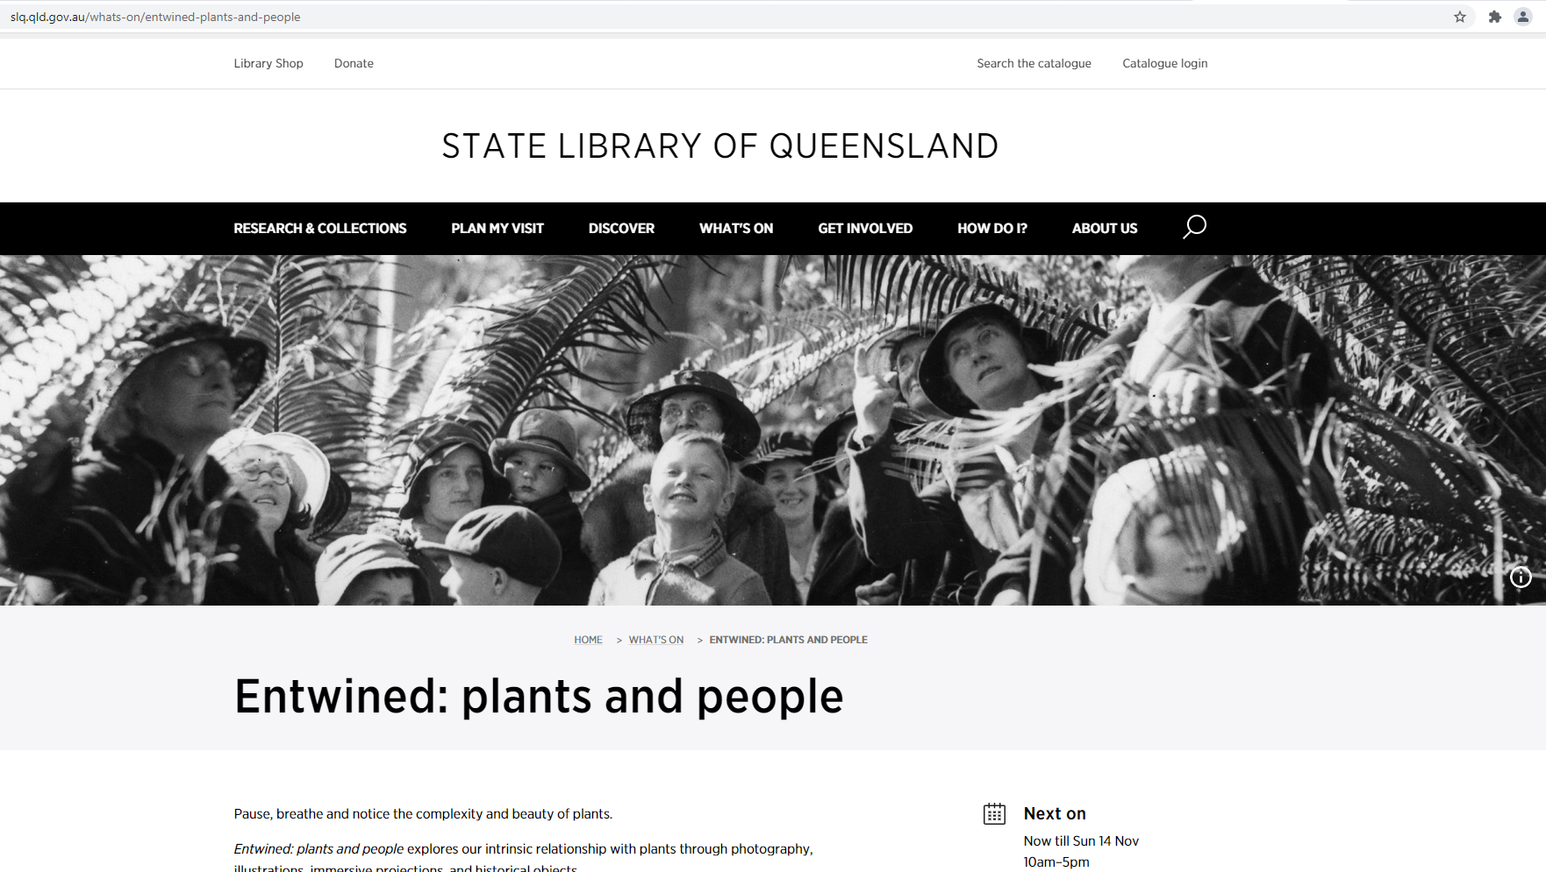
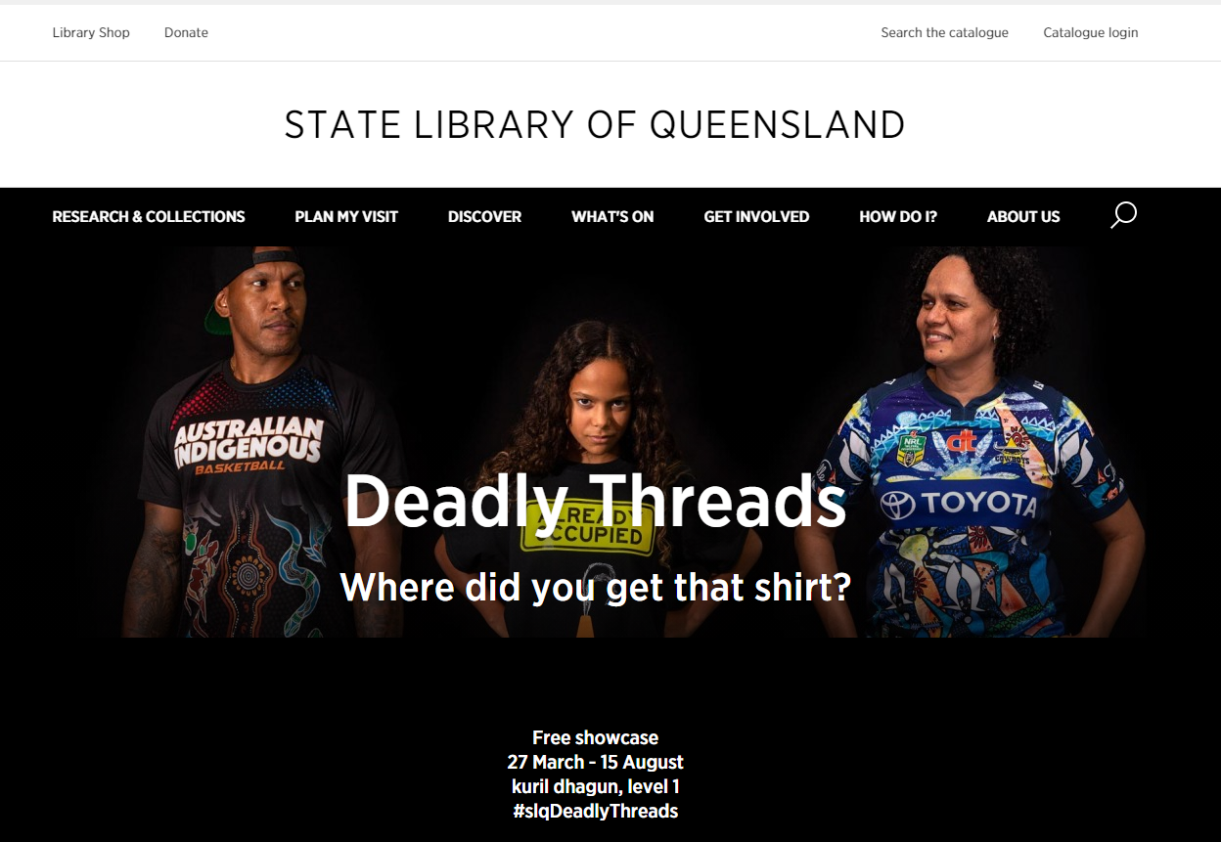
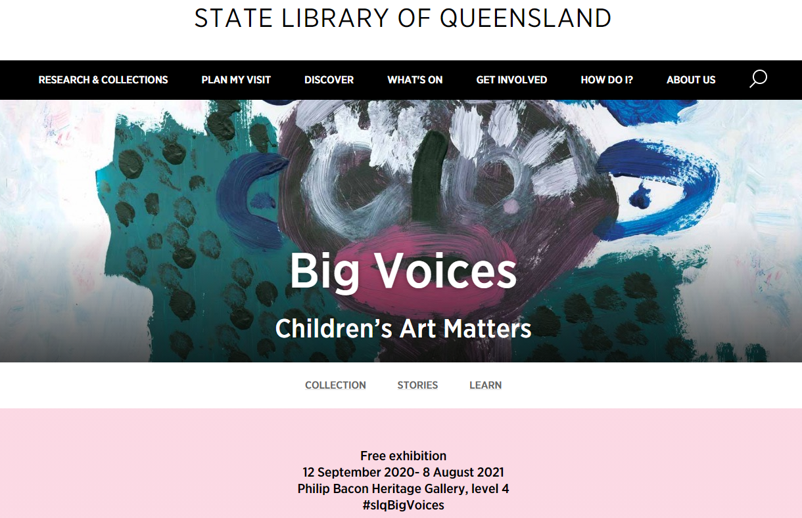
State Library stimulus experiences
excursions
Exhibitions
Current
Entwined: plants and people
Big Voices: Children’s art matters
Deadly Threads
Notes:
Current onsite exhibitions and coming up
Now until 14 November 10 am – 5 pm daily SLQ gallery
Pause, breathe and notice the complexity and beauty of plants.
Entwined: plants and people explores our intrinsic relationship with plants through photography, illustrations, immersive projections, and historical objects.
In this evocative State Library of Queensland exhibition, Entwined displays the transformative works of award-winning creatives as they document and reinterpret plant life in modern Australia.
Entwined also digs into State Library’s rare and beautiful botanical collections, exploring our day-to-day connection with plants, unfurling fascinating historical and contemporary stories in the process.
See how our lives are experienced and, at times, defined through our interactions with plants across social, emotional, scientific, and creative endeavours.
Highlights include:
Joseph Banks' Florilegium and the works of Ferdinand Bauer
Man & Wah’s immersive videography and Donna Davis' creative plant displacements
The rare and unique Queensland Nineteenth Century Fern Album 1883-1884
Aboriginal and Torres Strait Islander traditional knowledge of plants as technology in Bicornual baskets, Wujal Wujal mullet spear making and Kowanyama basket making
Enjoy in-person tours of the exhibition to deepen your connection to plants.
Join a workshop or talking event to continue the broader conversation of plants and people.
Big Voices – resource for this-
On until 8 August
Deadly Threads
Free showcase 27 March - 15 August kuril dhagun, level 1 #slqDeadlyThreads
Deadly Threads is a showcase of singlets, shirts, polos and jerseys created by Aboriginal and Torres Strait Islander peoples from across Queensland.
It explores the significance of these pieces as symbols of identity, celebration and unity. They have been developed to protest, commemorate special occasions and historical events and tell stories of Aboriginal and Torres Strait Islander history and cultures.

Slide 16
State Library stimulus experiences
excursions
Exhibitions
Coming up:
Viewpoints- photography through the lens of First Nations photographers
Sovereign Stories- Celebrating a decade of Black and Write
Notes:
If you also teach English- Sovereign Stories
black&write! is here for all First Nations writers and editors. We are a national project with a dual focus on First Nations writing and editing. We’re also the first project of our kind in Australia. Check out more about the current team and the black&write! history.
The Writing Fellowships
The black&write! Writing Fellowships are offered annually to two Aboriginal and/or Torres Strait Islander writers. The fellowships include a prize of $10,000, editorial development and publication opportunities. The 2022 Fellowship competition will open later this year. Find out more about submitting to the competition.
The Editing Internships
The black&write! Editing Internships recruit, train and mentor Aboriginal and/or Torres Strait Islander editors. Interns get hands-on editing experience while working on the winning Fellowship manuscripts.

Slide 17
State Library stimulus experiences
excursions
Exhibitions
Permanent
Fiona Foley’s Black Opium
Megan Cope’s Maiwar Yunggulba
Gallery Walk self guided
Australian Library of Art- artists books
Notes:
Black Opium is located on level 4 and acts as a prelude to the John Oxley Library.
Suspended poppy heads arranged in the shape of the infinity symbol connect to a series of seven small rooms representing different ambiances and cultures, exploring themes of history, memory and politics through sculptural installations and photographs. Black Opium was commissioned as part of the State Library's 2006 redevelopment and was designed to draw visitors along the Knowledge Walk.
Foley says her work gives Queenslanders an opportunity to confront and understand parts of their history.
Black Opium has a dedicated webpage – which includes some essays and critical writing to help students understand the concepts and the work.
MAIWAR Yunggulba by Megan Cope
A continuation of the Yunggulba works within the After the Flood series, this artwork explores toponymy and geomorphology, climate change and sea level rise. Cope recreates a sense of place and identity by overlaying topographical military maps with Aboriginal place names revealing alternative historical narratives. The piece challenges notions of ownership and colonial dominance.
Gallery walk https://www.slq.qld.gov.au/gallerywalk webpage and downloadable map.

Slide 18
https://curriculumconnect.slq.qld.gov.au/
Notes:
https://curriculumconnect.slq.qld.gov.au/
Demo if live internet
This is just the beginning we need your input..
- Live chat function- let us know if you are experiencing difficulties or if links don’t work
-more content under development..
subscribe to newsletter for updates.

