Slide 1
Building
Volunteer
Networks
That
Rock
Jacinta Sutton
State Library of Queensland

Slide 2
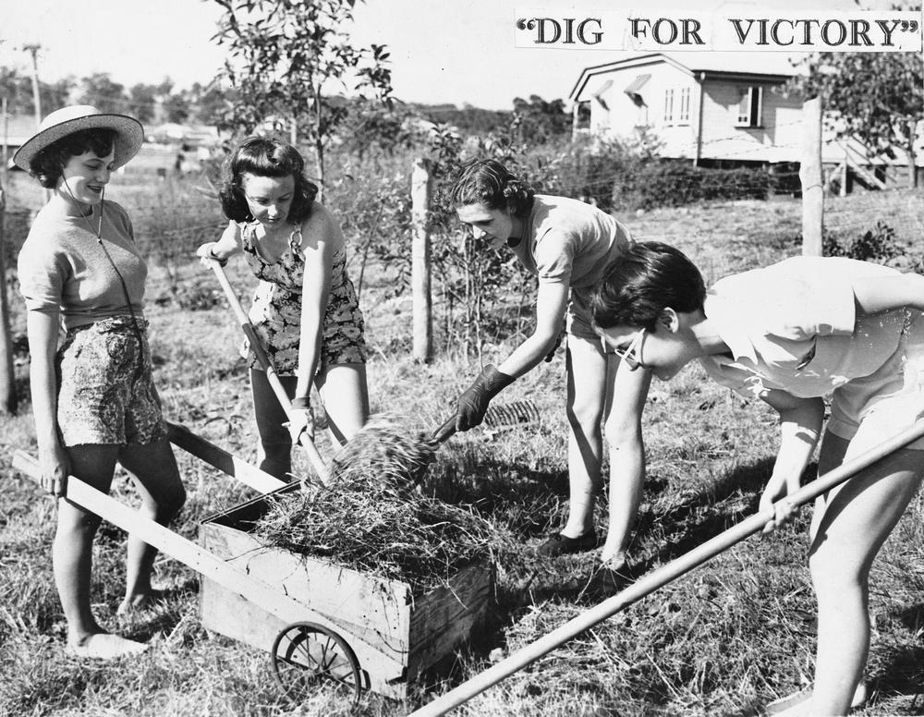
Volunteers are part of the library ecosystem
Our libraries raise the consciousness of our communities
Volunteer programs engage the support of the community – and for the volunteer to feel they add value to their community
Integral to maintaining a library’s public awareness

Slide 3
Why should this matter to you?
Libraries are inclusive places where diversity and contribution is valued
Be a leader and start thinking about volunteers differently
Harness the energy of your community
Move away from the traditional ‘us and them’ and toward ‘us’
Libraries build social capital

Slide 4
What does this mean for my career?
PD Opportunities are up for grabs
Management experience
Learn how to manage people and teams
How to identify people’s skills and apply them – a hallmark of good leadership
Project management
Learn how to manage projects
Lead and deliver a project – if you can do it with volunteers you can do it anywhere
Enterprise
Raise the profile of yourself and your library
Focus on inclusion of your community
Help implement a volunteer program at your library

Slide 5
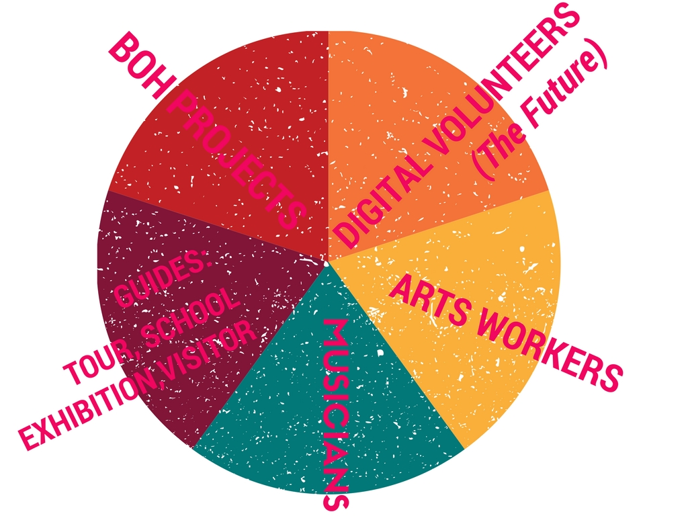
The Hive
SLQ:
150 registered volunteers
100 currently active
300 on waiting list

Slide 6
Context is everything
SLQ Strategic Plan 2016 - 2020
Enable Access
Provide life skills and early childhood literacy programs
Increase free access to digital content
Strengthen Queensland library infrastructure and discovery platforms
Engage Community
Engage with communities of interest through dedicated centres of engagement
Facilitate the community’s use of and interaction with content
Build capability
Build capacity within our communities of interest

Slide 7
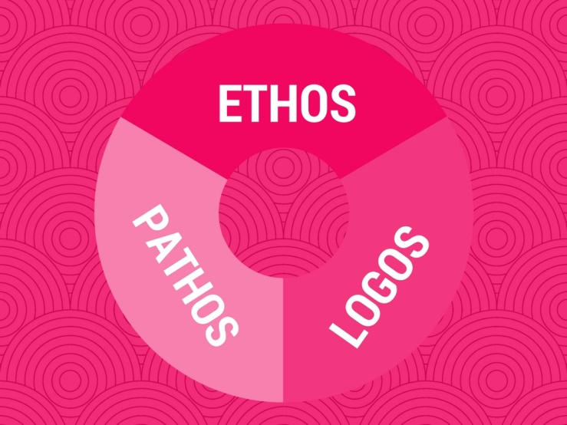
The steak to the sizzle

Slide 8
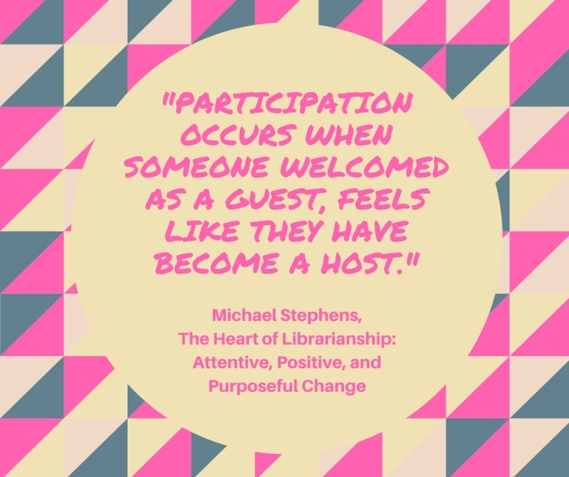
And the tofu to the marinade

Slide 9
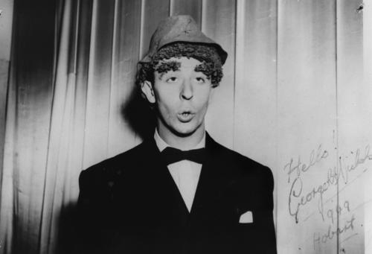
Keep it real
George Nichols, 1949. John Oxley Library, neg number: 151318

Slide 10
Nikki
Elise
Glen

