Slide 1
VALA Events 2021: 2020 VALA Award for Crisis Response - #1 – State Library of Queensland presents “ANZAC Stories” Presenters: Anna Raunik and Linda Barron – SLQLD Host: Melissa Parent, VALA Vice President Wednesday 24 February 2021 12.00 – 1.00pm AEDT Zoom Webinar

Slide 2
2020 VALA Award for Crisis Response
Anzac Stories
State Library of Queensland
Notes:
I to would like to acknowledge Aboriginal and Torres Strait Islander peoples and their continuing connection to land and as custodians of stories for millennia. I am inspired by this tradition in our work to share and preserve Queensland's memory for future generations
Thank you .. great to be here to share this initiative and to explore opportunities for libraries
It’s fantastic to have library staff from around Australia and from different sectors – I should start with some scene setting

Slide 3
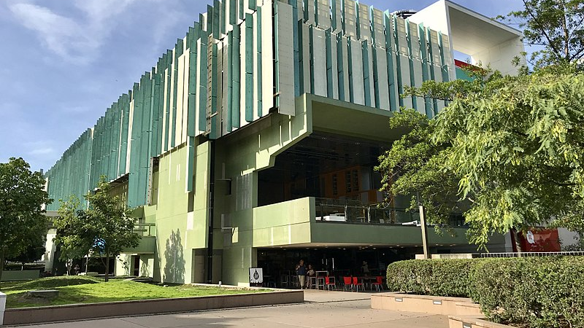
Notes:
State Library of Queensland is the leading reference and research library in Queensland. We are responsible for collecting and preserving a comprehensive collection of Queensland’s cultural and documentary heritage, providing free access to information for all Queenslanders and for the advancement of public libraries across the State

Slide 4
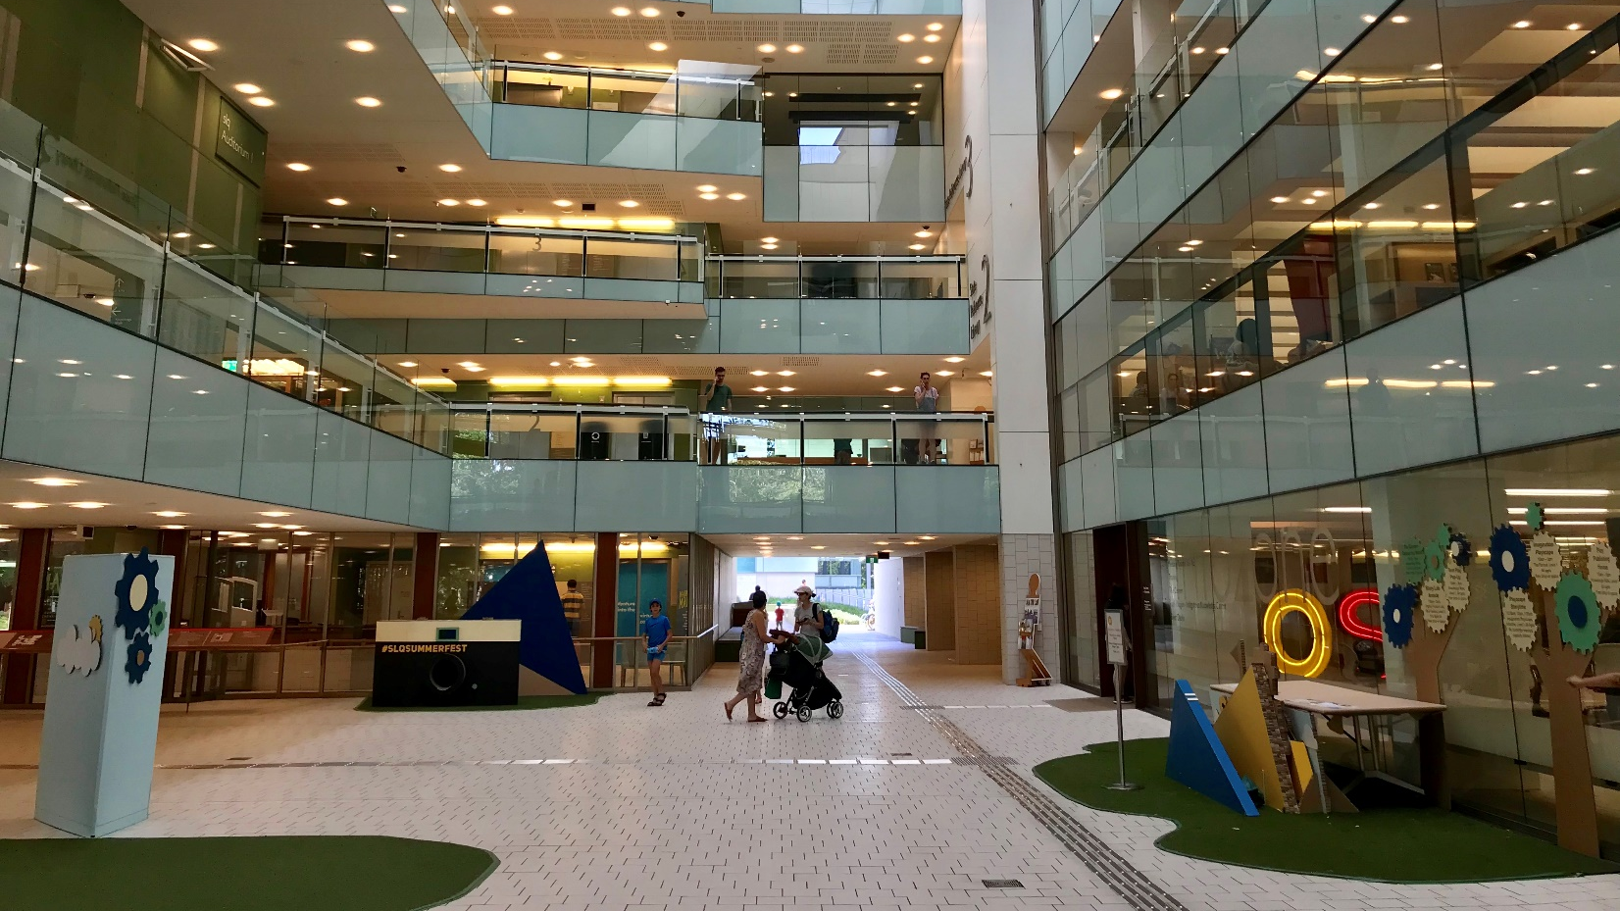

Slide 5
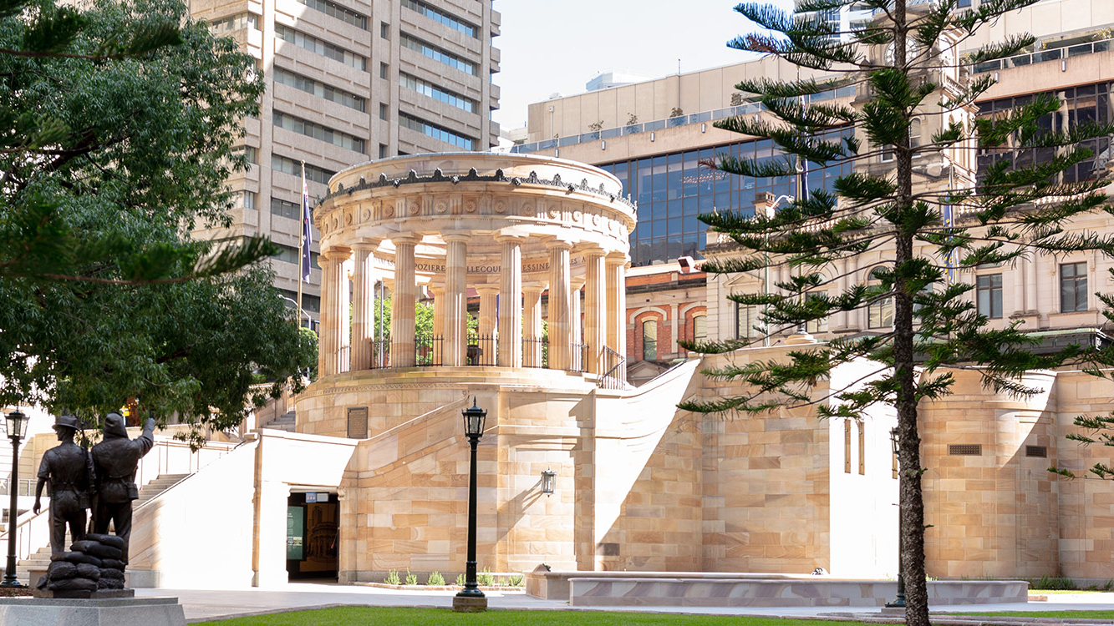
Notes:
As part of the World War I Centenary commemorations – Anzac Square in Brisbane’s CBD underwent major redevelopment
In 2019 State Library was approached by the Queensland Government to curate the online exhibition spaces in the undercroft or Anzac Square Memorial Galleries

Slide 6
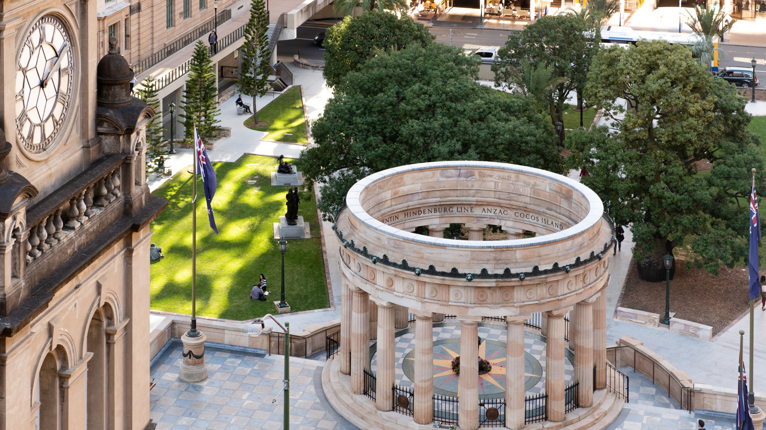
Notes:
The Galleries under the Shrine of Remembrance was envisaged as a memorial space showcasing plaques that had been placed in the Shrine since 1930 and digital interactive content from our collection

Slide 7
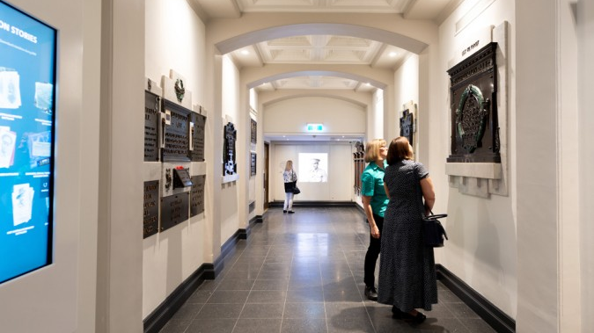
Notes:
There are three galleries – World War I

Slide 8
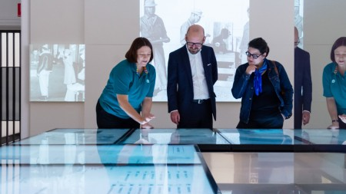
Notes:
World War II

Slide 9
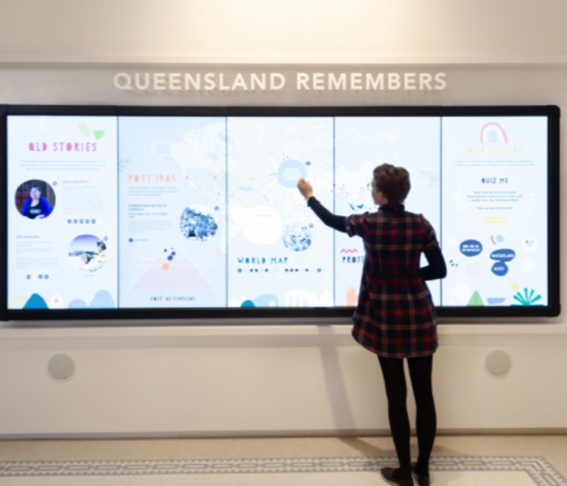
Notes:
Post War II – Peacekeeping

Slide 10
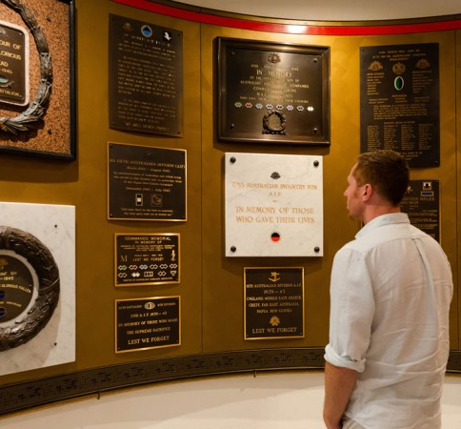
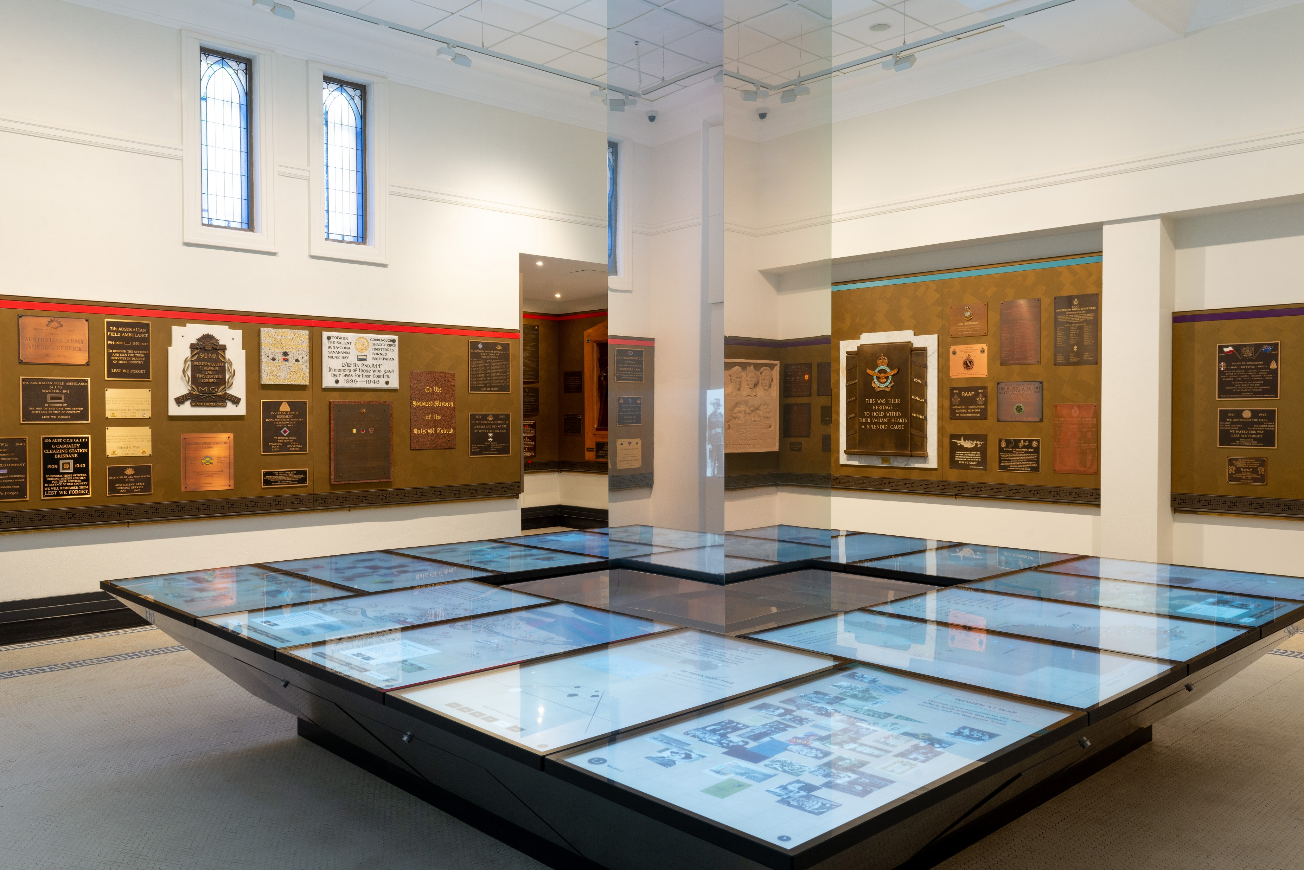
Notes:
Mix of traditional plaques and contemporary interactive content
The initial curation work was extended to provide customer service role at the Galleries and online

Slide 11
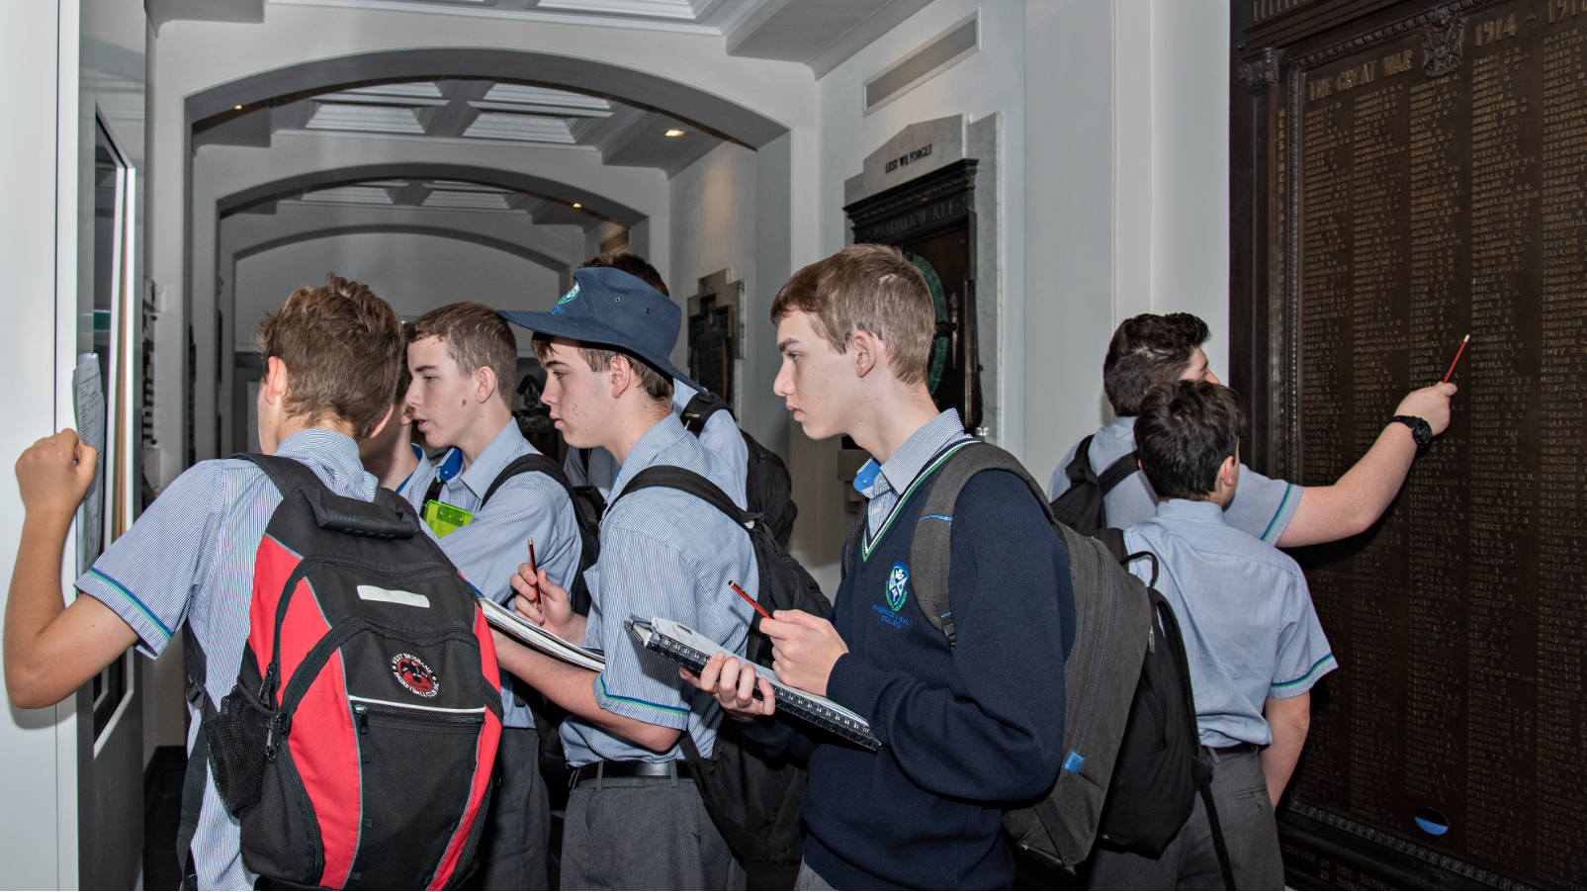
Notes:
State Library staff take responsibility for tours – engaging with visitors, helping with use of digital screens.. answering questions, school and visitor tours

Slide 12
Notes:
One of the principles of the redevelopment was for Anzac Square to be recognised as a state memorial .. a new website and online content was fundamental to this principle.

Slide 13
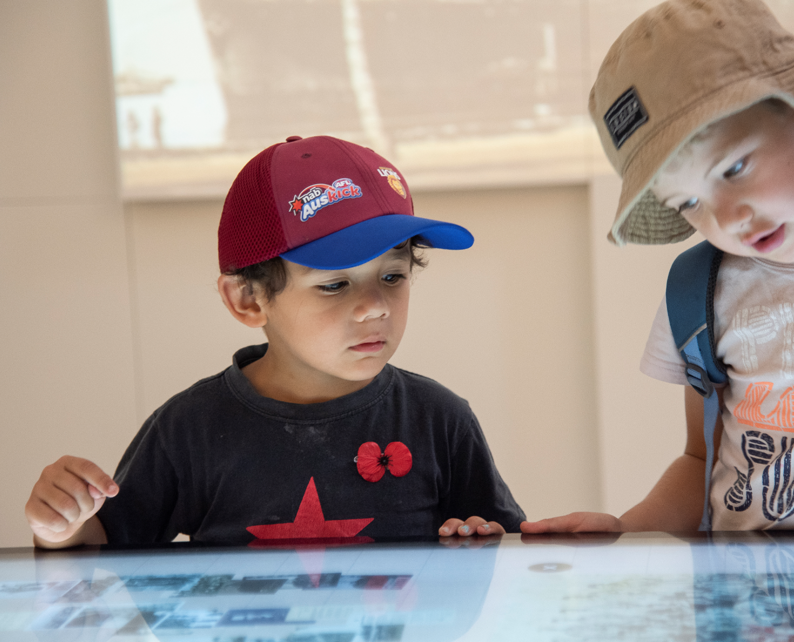
Notes:
The redeveloped Anzac Square with State Library staff opened on 2 July 2019
Visitation was tracking well.. relationships was underway with key stakeholder organisations – planning for Anzac Day 2020 as the major commemoration event of the year started early

Slide 14
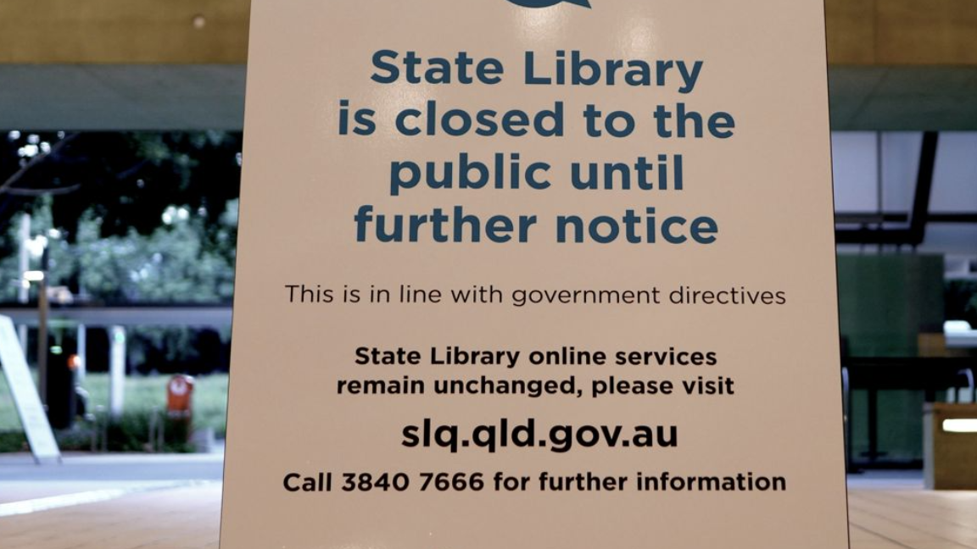
Notes:
March 23..Lockdown in Queensland

Slide 15
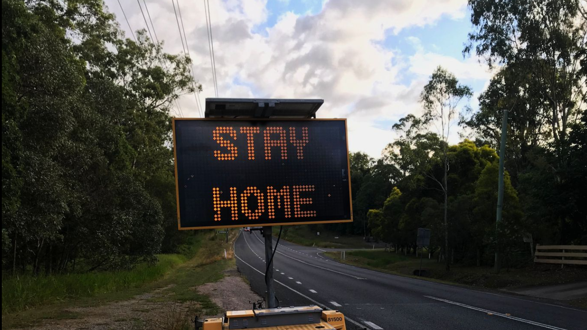
Notes:
While we were organising ourselves.. making sure staff were safe and occupied webpages updated etc.. the reality set in .. 23 days to Anzac Day

Slide 16
Commemorate Differently
Notes:
Linda’s team began working with staff from Marketing and Communications came up with Commemorate Differently campaign for Anzac Day – focused on our collections and supporting activities RSL light up the dawn
One idea that a staff member had was the option for staff to commemorate your behalf by placing a poppy in the gallery on the public behalf.. we were thinking email.. social media?

Slide 17
Photo by Jason Rosewell on Unsplash
Notes:
In 2019 State Library started working with Alkira – A Voice Company on a project focused on making State Library’s website and catalogue more accessible primarily for people with a disability
We had been hearing about voice skills.. and discussing ideas for how this new technology could be used at State Library..
Voice technology – seen by some as the new frontier.. sure most of us are using it when we are in a car and send a text message.. or use a home device to set an alarm .. allows for hands free
You may have used voice dictate option on your phone.. or laptop .. works pretty well.. you just feel silly talking to your laptop – Average typing speed is 40 words a minute compared to 100 words for taking..
One application that had been recently released by Alkira was RACQ app – where you could find the cheapest fuel in an area based on phone call – all by voice activation.
What sort of application would work for libraries…
The idea to build a voice activated skill to support Anzac Day – happened

Slide 18
Anzac Stories – project
.
Be transported back in time with Anzac Stories, through the diaries of Australian war heroes past and contemporary stories from those in service.
Project Brief – 3 week timeframe
Project Need – innovative online opportunity to engage communities
Project Budget – development, set up fees and ongoing hosting, marketing and advertising
Notes:
Alkira responded quickly and scoped the opportunity and started work.
True example of agile development
Anzac Stories
Be transported back in time with Anzac Stories, through the diaries of Australian war heroes past and contemporary stories from those in service.
Listen to moving memories from WWI, WWII and beyond curated by the State Library of Queensland for Anzac Square Memorial Galleries.
Request a poppy be laid at Anzac Square on your behalf, hear The Last Post and be led in a minute's silence on Anzac Day
Project Brief
Alkira was given 3 weeks to produce a voice activation engagement to highlight historical and contemporary content from State Library's collections. Additionally, to develop a method for audiences who were unable to visit the Galleries in person the opportunity to place a poppy on one of the over 200 plaques in the space.
This was also an opportunity for State Library to explore voice activation as a new service for people with a disability and for users who prefer voice to keyboard access.
Project Need
Anzac Stories was developed as an innovative online opportunity to engage communities in lockdown during Covid-19 to Commemorate Differently.
The conversational application offers users an opportunity to ask for a poppy to be placed in Anzac Square Memorial Galleries, listen to the last post and a range of stories from State Library’s collections.
It was developed as an alternative to attending dawn Anzac Day services and/or Anzac Square Memorial Galleries.
It also provided the opportunity to connect with Queenslanders throughout the State who cannot visit Anzac Square.
The conversation application enabled State Library to explore new approaches to engage with communities and to expose our collections.

Slide 19
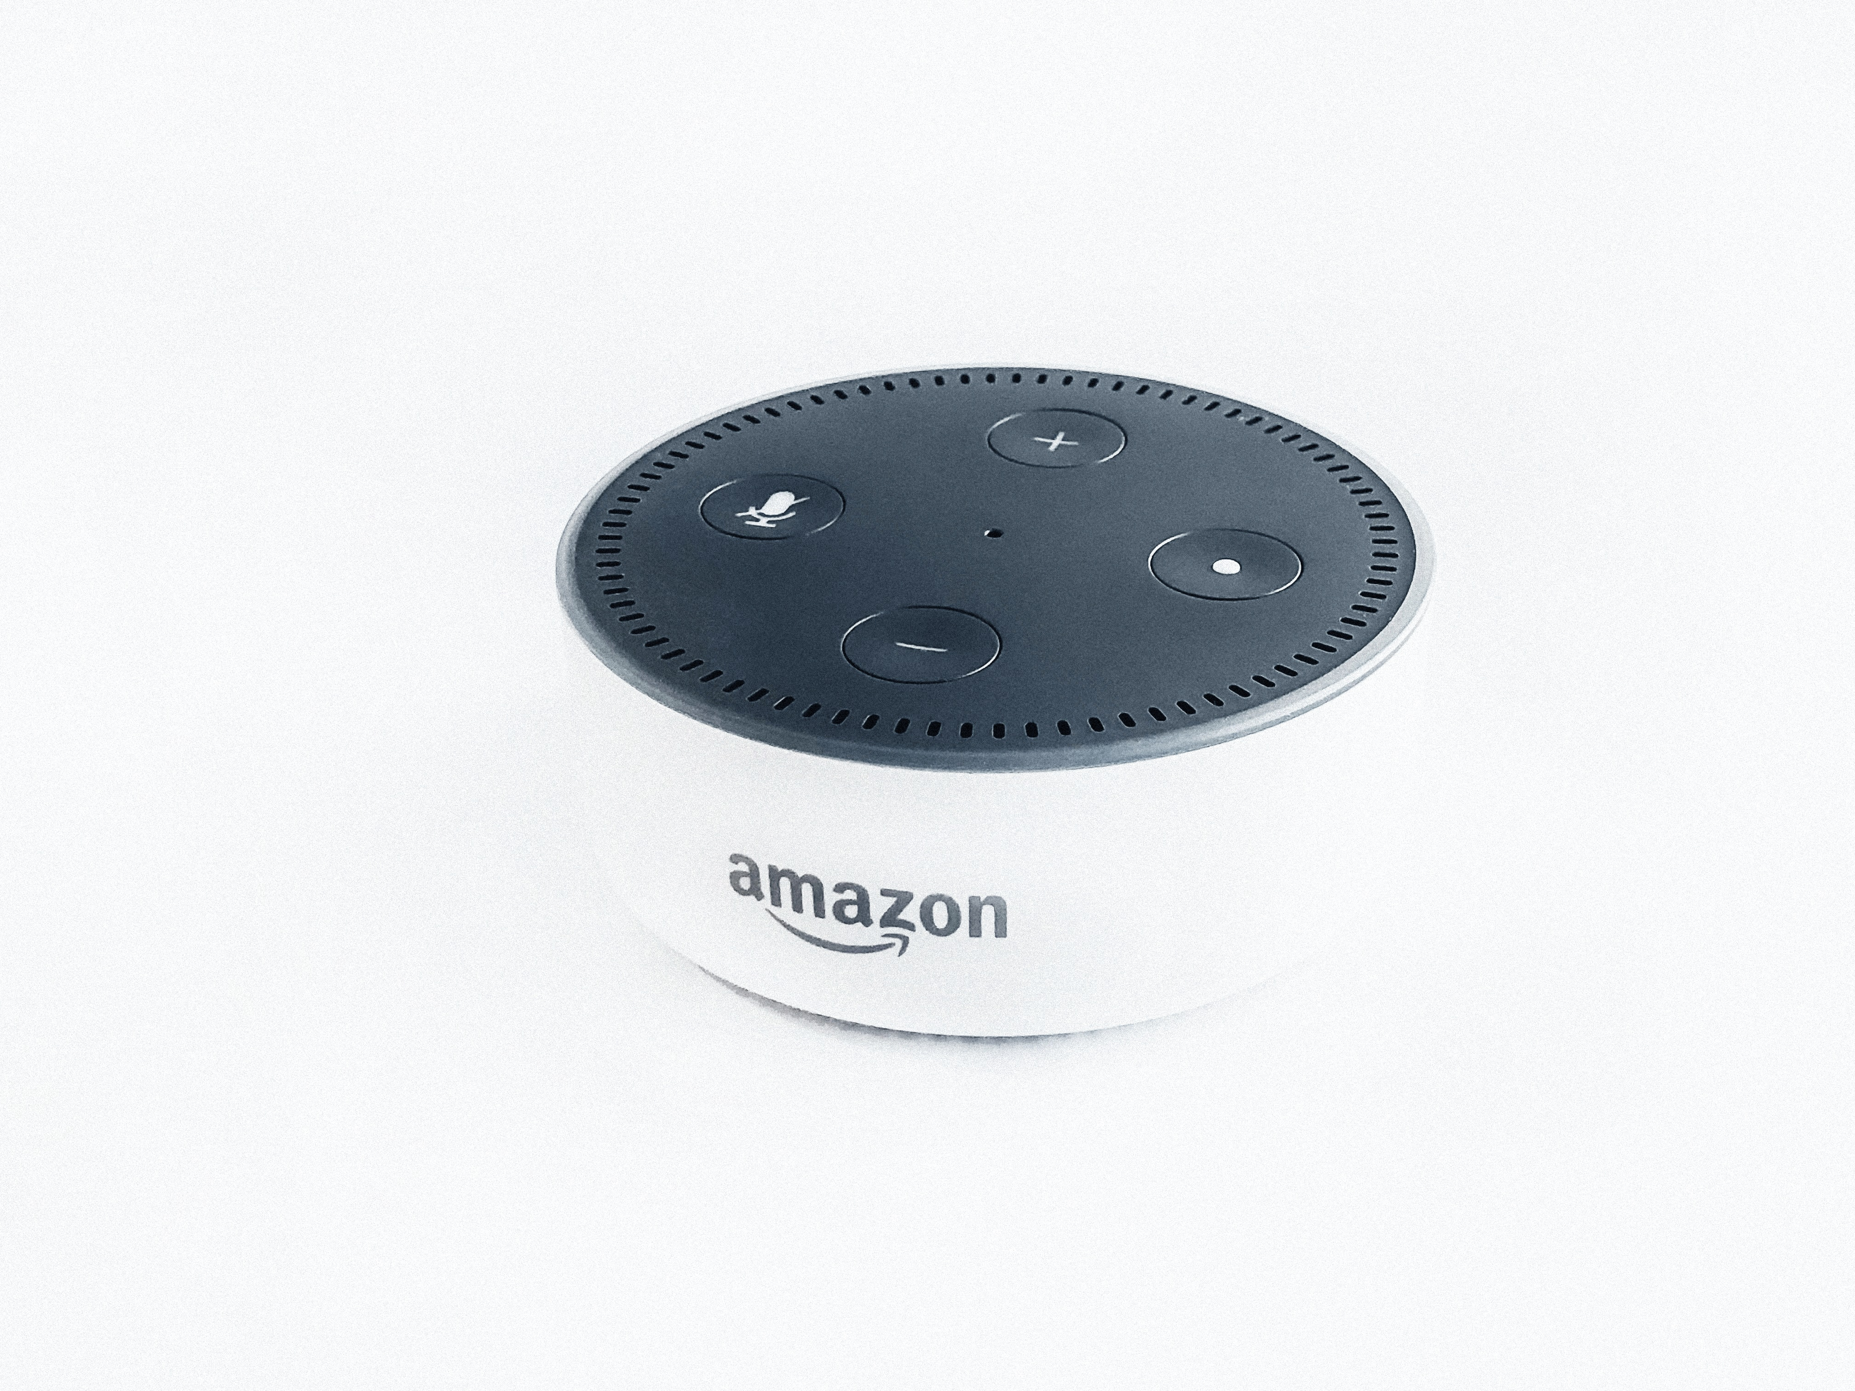
Launch Anzac Stories
Notes:
Voice skill is available on smart devices your phones android or iphone via Google Assistant and smart home devices echo.. google home
You need the trigger words.. in our case we decided on Launch Anzac Stories..
Hear a snippet
User Experience
Accessing Anzac Stories is simple with activation of key phrases to voice assistant or smartphone/device.
Say ‘Launch Anzac Stories’ to hear a selection of oral histories from past and present serving members of the armed forces or stories retold from letters and diaries.
Say ‘Ask Anzac Stories to place a poppy’ and State Library staff will lay a poppy in Anzac Square Memorial Gallery or beside a memorial plaque of your choice. You can request email confirmation that your poppy has been placed, along with an image as a keepsake. Images of placed poppies will also appear on Anzac Square Memorial Gallery social media.
Say ‘Ask Anzac Stories to Play the Last Post’ to conduct a virtual service and observe a minute’s silence from home.
If you don’t already have an Alexa or Google Assistant-enabled device, you can still access the service by downloading the Amazon Alexa or the Google Assistant app onto your smartphone.
Users had the opportunity to request for an image of Anzac Square gallery and nominated plaque with poppy to be emailed to them. This provided the opportunity for State Library to connect with users and forward information about Anzac Square and the collections at State Library

Slide 20
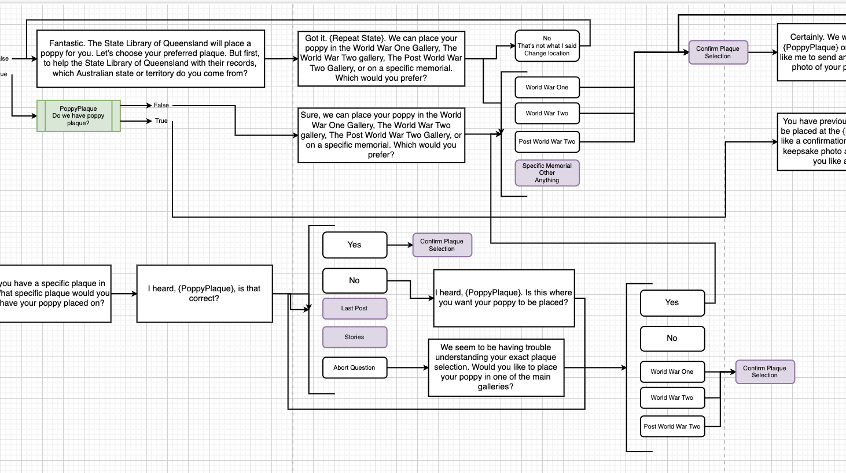
Notes:
An exciting option in Anzac Stories – is the opportunity to enable users to place a poppy in the memorial
Here is the flowchart of the process that we worked on with Alkira to ensure a smooth and engaging process.. where you didn’t get lost. This could be seen as one of those interactive voice engagements we’ve all had on the phone press 1 for.. we definitely didn’t want that

Slide 21
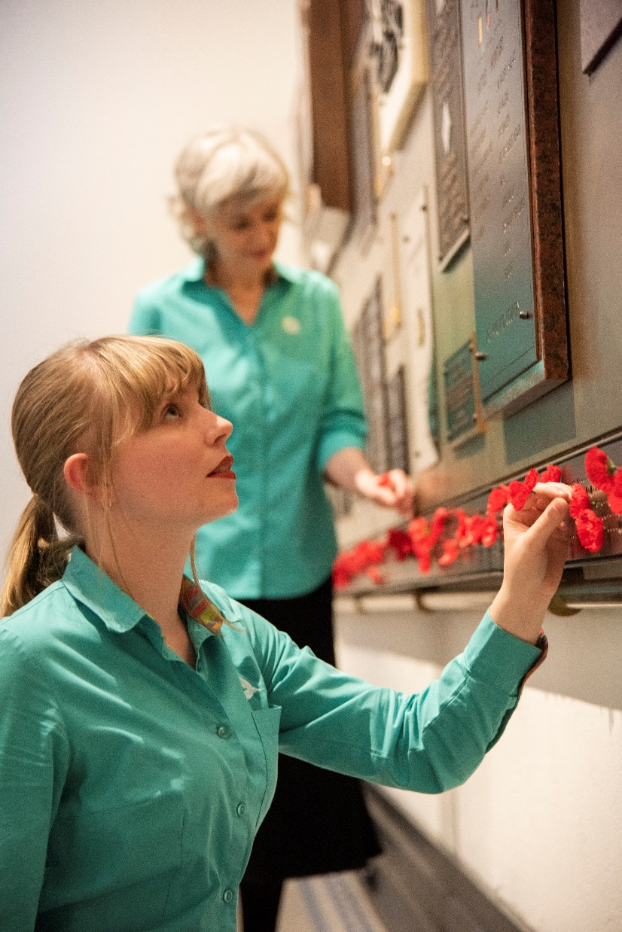
Notes:
Poppy story
Let’s hear how it works
Users had the option to ask for an image of their poppy sent via email
This was a great opportunity for us to connect with users – sends links to content.. websites etc

Slide 22
Anzac Stories – Marketing
Marketing and Communication plan
Media release by the Premier of Queensland Media reports included
Channel 9 News story Thursday 23 April 2020
Advertisement of Commemorate Differently in Courier-Mail on Friday 24 April 2020
ABC Radio (Brisbane and Gold Coast) interview 25 April 2020
enewsletters distributed by State Library
State Library homepage feature
Amazon /Alexa newsletter and feature
Notes:
Marketing – Premier.. Amazon
Project Marketing
Marketing and Communication plan was developed an involved a range of activities
*Media release by the Premier of Queensland http://statements.qld.gov.au/Statement/2020/4/25/queenslanders-light-up-the-dawn
Media reports including
*Channel 9 News story Thursday 23 April 2020
*Advertisement of Commemorate Differently in Courier-Mail on Friday 24 April 2020
*ABC Radio (Brisbane and Gold Coast) interview 25 April 2020
*Enewsletters distributed by State Library of Queensland
*State Library of Queensland homepage feature
*Amazon /Alexa newsletter and feature

Slide 23
Measuring success 21 – 30 April
6,593 unique users
12,302 visits (sessions)
4,095 engagements with 'Commemorate Differently" - to place a poppy, play an Anzac story or play the last post
265 requests for poppies to be laid at Anzac Square Memorial and Galleries
People from all over Australia, as well as the USA, NZ and the UK request poppies - which is an exciting demonstration of reach
People spent almost 6 minutes on average exploring the content which shows engagement levels were high
High traffic to “Commemorate Differently” voice-activated tool from Amazon Alexa demonstrating the impact of Amazon support
Notes:
Success .. post Anzac Day.. Collection views/listen December 12,000
“There was an increased usage on the week before Remembrance Day with 13,000 Last Post plays and 15,000 views and 24,000 sessions”.
Measuring the success of the project between the 21 - 30 April
• 6,593 unique users
• 12,302 visits (sessions)
• 4,095 engagements with 'Commemorate Differently" - to place a poppy, play an Anzac story or play the last post
• 265 requests for poppies to be laid at Anzac Square Memorial and Galleries
• People from all over Australia, as well as the USA, NZ and the UK request poppies - which is an exciting demonstration of reach
• People spent almost 6 minutes on average exploring the content which shows engagement levels were high
• High traffic to “Commemorate Differently” voice-activated tool from Amazon Alexa demonstrating the impact of Amazon support
Good to highlight success test

Slide 24
Measuring success post Anzac Day 2020

Slide 25
Issues and Learnings “Building a voice app is more than just programming in some questions and answers. It’s about building an intuitive, interactive, empathetic conversation between an A.I. platform and a real person”.
Clear objectives
Manage privacy requirements
More time
Test and test again with different users
Audio files were required
Develop tips for the community and staff i.e. search Google Assistant not Google
Leverage your stakeholders – RSL, Legacy Qld
Ensure you have the staff to deliver on your commitment
Take advantage of opportunities .. Project with Alkira
Notes:
Issues and learnings
Project Privacy
• No specific user details are captured, a deviceId is all that is captured unless the user provides their email address to have additional info sent (in this case a photo of a poppy or instructions on how to share)
• All connections are encrypted over SSL
• Incoming requests are validated to ensure communication with a valid provider e.g. Is the certificate sent by Alexa
• Backend APIs all use token authentication. This means only authenticated voicebots can communicate with our apis to retrieve user data.
• User data is stored securely in Azure cloud servers

Slide 26
Notes:
Public feedback
Positive.
Tweet from UK on Anzac Day

Slide 27
2020 VALA Award for Crisis Response
YBF Ventures
Best Australian Collaboration During a Crisis: Alkira Software & the State Library of Queensland for Anzac Stories
YBF Ventures global-reaching network and leverage the expertise of local startups, scaleups and innovators.
Notes:
Recognition – outside sector
This recognition complements two other awards for Anzac Stories: voted Best Collaboration During a Crisis at the 2020 Online Startup and Innovation Awards and Silver Award winner (Digital - Expanded Service or Application) at DrivenxDesign BNE20

Slide 28
What’s next – Anzac Stories
Anzac Day 2021
First 5 Forever – voice activated tips for busy parents and caregivers
Talkviainclusion
Notes:
Extension – Victory in Pacific anniversary.
Anzac Day 2021
First 5 Forever – early literacy programme at State Library – voice activated tips for busy presents
Talkvia inclusion

Slide 29
What’s next – libraries
Opportunity to share content and services
Engage with clients – in their space
What’s on
Exhibitions
Voice as biometric?? Authentication made easy?
More

Slide 30
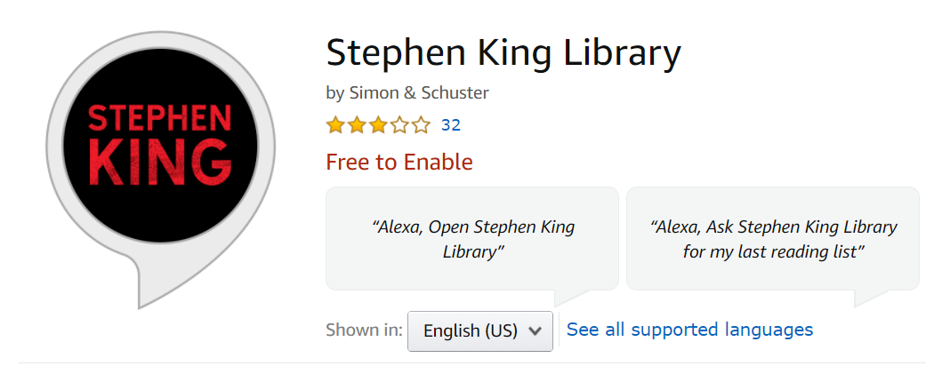
https://www.amazon.com/Simon-Schuster-Stephen-King-Library/dp/B07DD36TG7
Notes:
Stephen King is a master storyteller who has written more than 50 books. Which book should you read first? Which book should you read next? By answering a series of questions, you will receive a reading list of Stephen King books best suited to you. If you are ready for your next great read, just say, “Alexa, open Stephen King Library.”
https://www.amazon.com/Simon-Schuster-Stephen-King-Library/dp/B07DD36TG7

Slide 31
What’s next – challenges
A transaction or more??
Challenge – vendors LMS /Websites
Understand / support clients with privacy issues
Misinformation/conspiracy? regarding mobile devices
Advocate

Slide 32
Find out more
Anzac Square – Commemorate Differently
Alkira – video of Anzac Stories development
First 5 Forever – voice activated tips
Contact us..
Anna Raunik anna.Raunik@slq.qld.gov.au
Linda Barron linda.barron@slq.qld.gov.au

Slide 33
VALA Events 2021:
2020 VALA Award for Crisis Response
State Library of New South Wales presents “The Diary Files”
Wednesday 17 March 2021 12.00 – 1.00pm AEDT
VALA 2021 Annual General Meeting
Wednesday 30 June 2021 Time TBA

Slide 34
When: Various Dates throughout April 2021
Where: Online AND at venues across Australia and New Zealand
https://www.vala.org.au/events/vala-tech-camp-2021/

